Slide 1
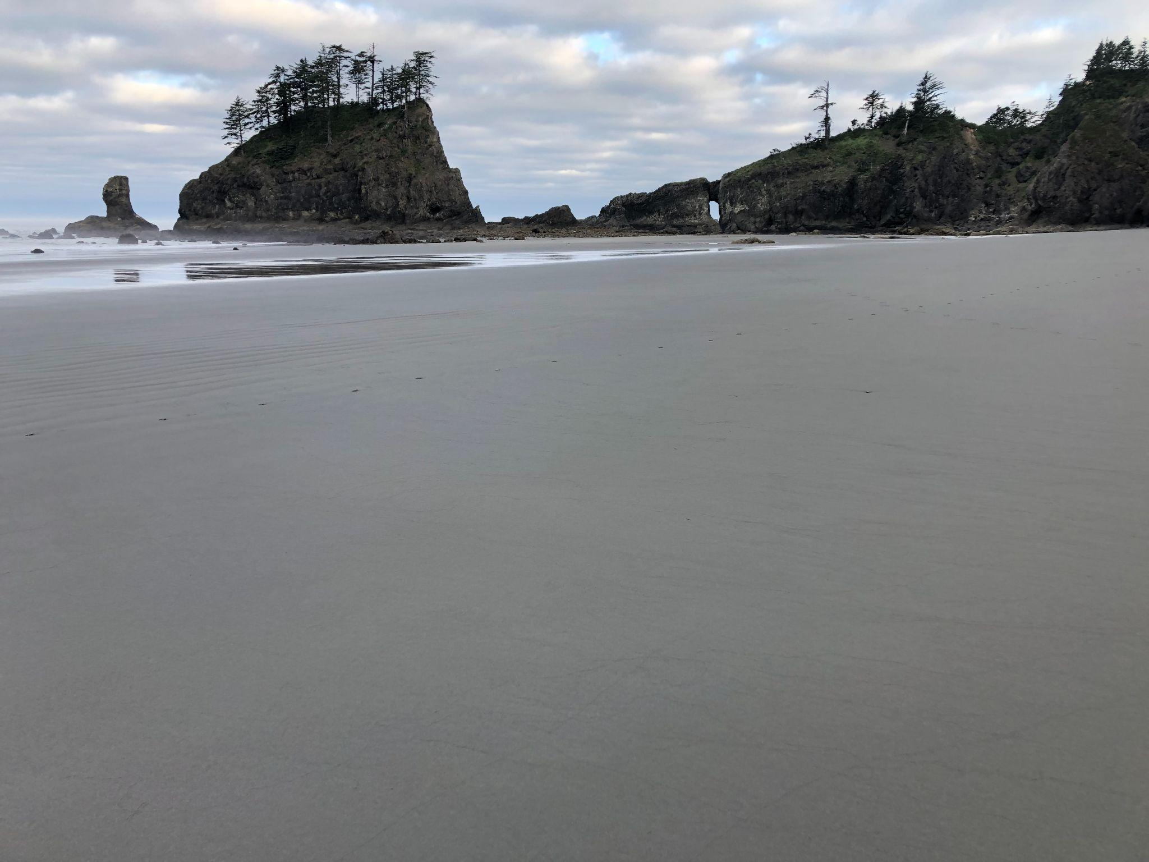
Management Transition Advisory Group for the PNW Multi-stressor Research Project
Meet & Greet
11 December, 2023

Slide 2
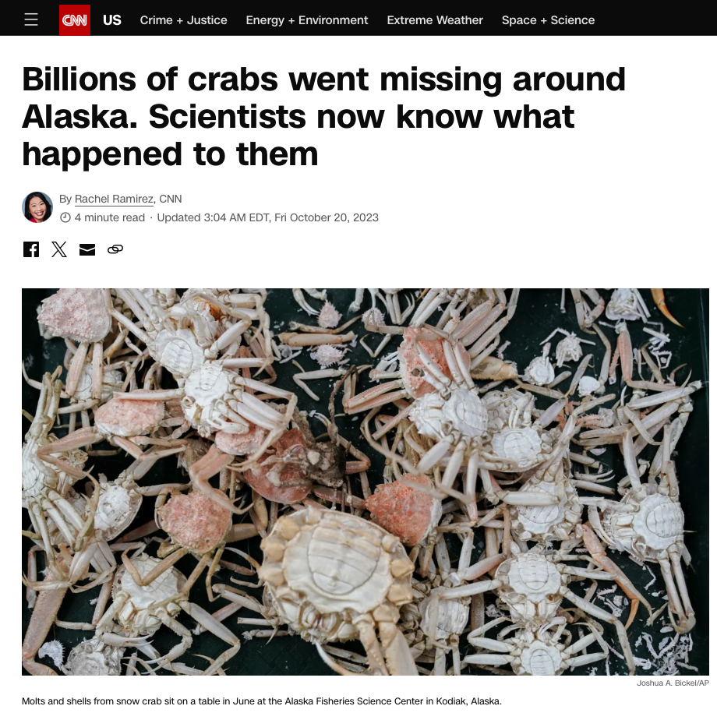
Can we avoid this?

Slide 3
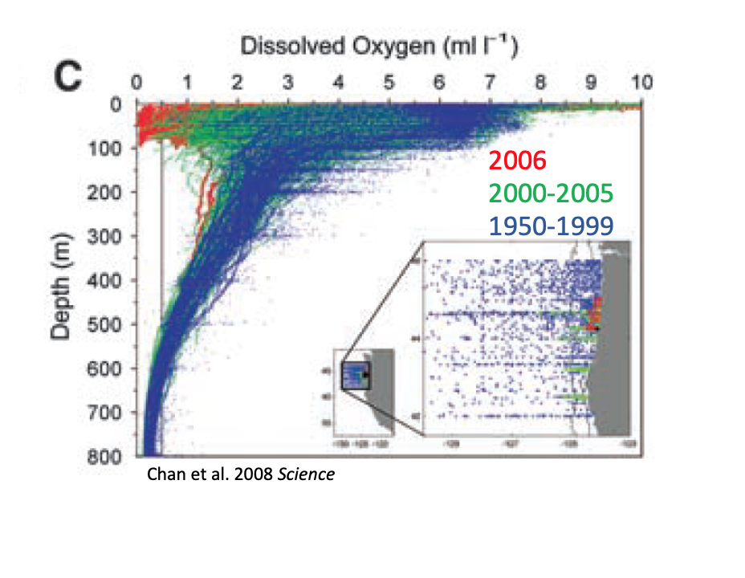
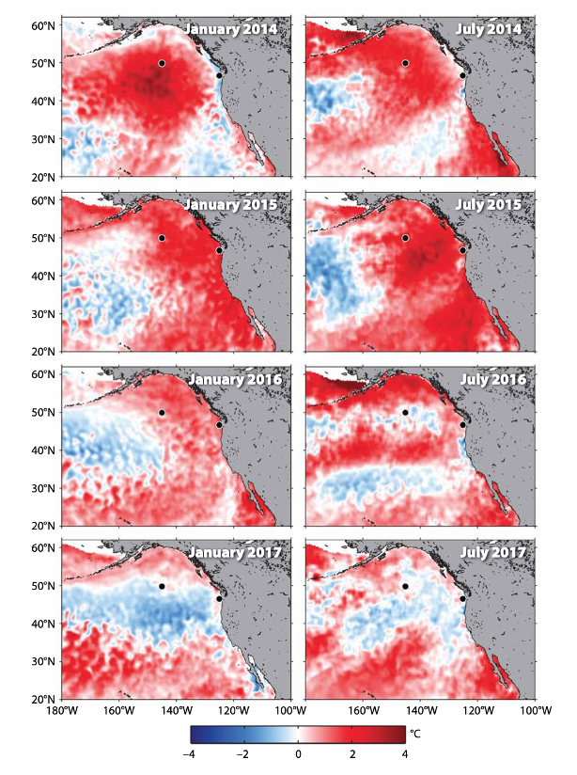
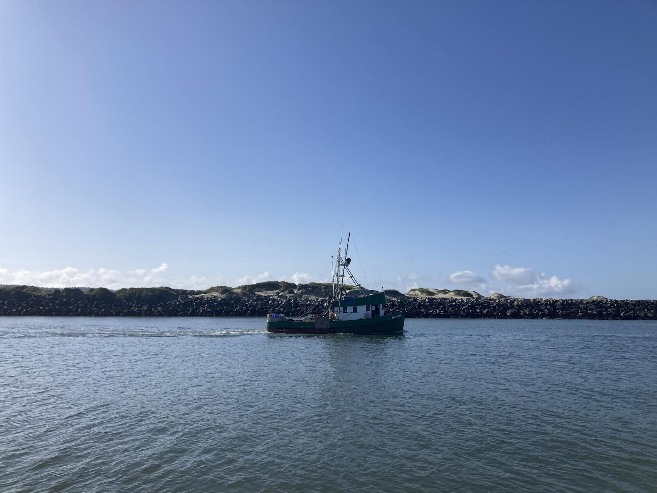
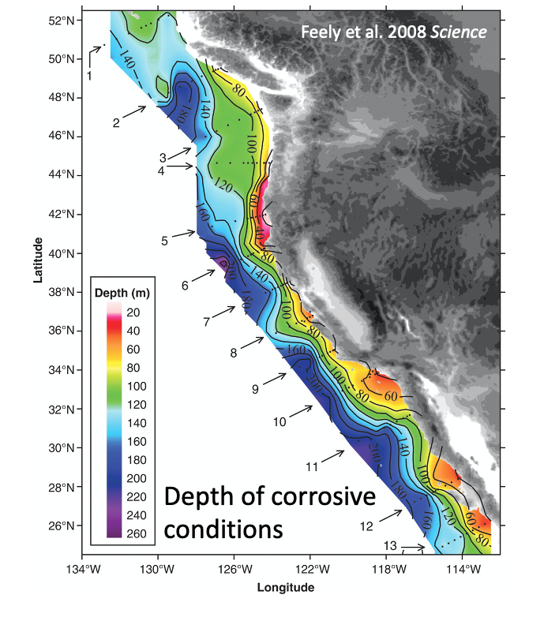
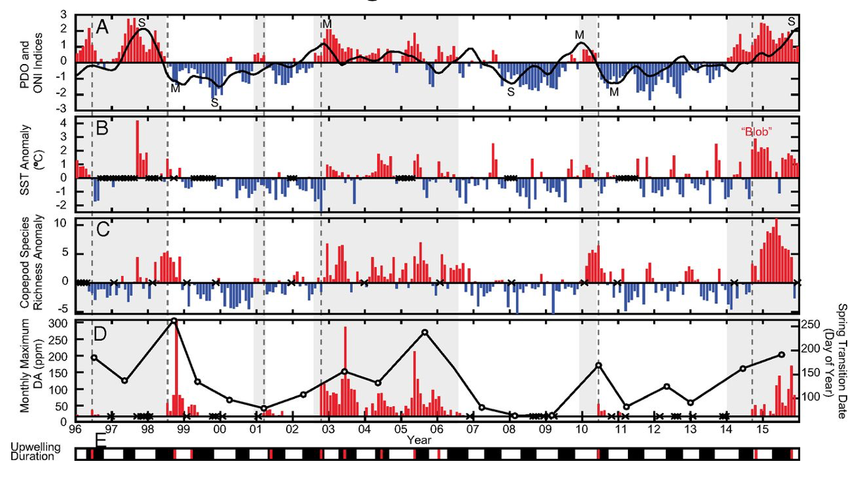
Multiple Stressors are landing together on our shores
hypoxia
marine heatwaves
ocean acidification
Harmful algal blooms
Can we put science to work?

Slide 4
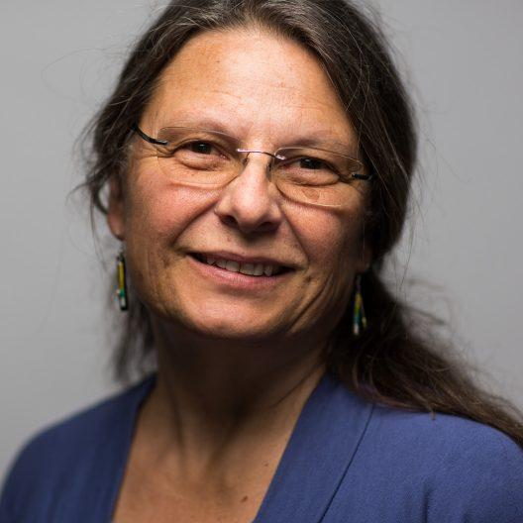
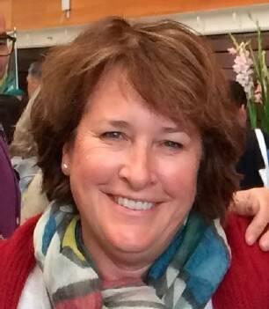
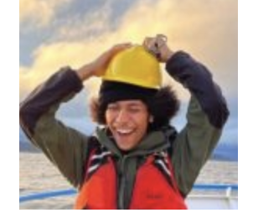
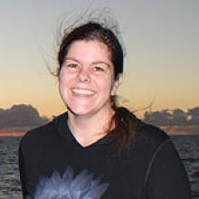
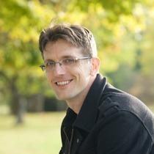
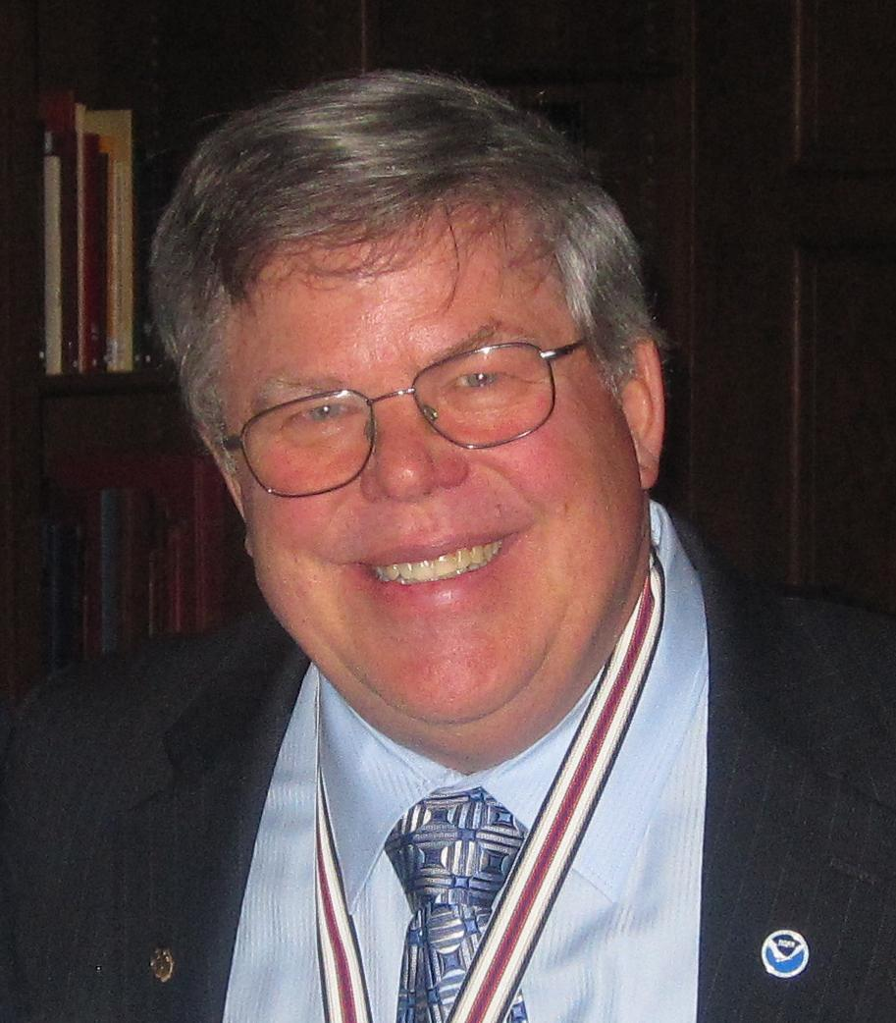
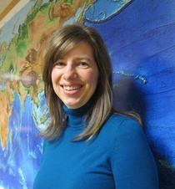
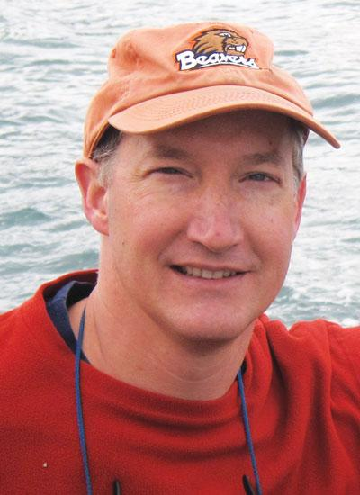
Our Objectives:
Objective 1: Construct a comprehensive synthesis of multi-stressor exposure in the nCCE
Why do this? We don’t have a complete picture of the risks we face -where, when and how severely OA, hypoxia, marine heatwaves, and HABs are affecting different parts of our coastal ocean.
Jan Newton
Vera Trainer
Christian Swift
Maria Kavanaugh
Brendan Carter
Dick Feely
Simone Alin
Jack Barth

Slide 5
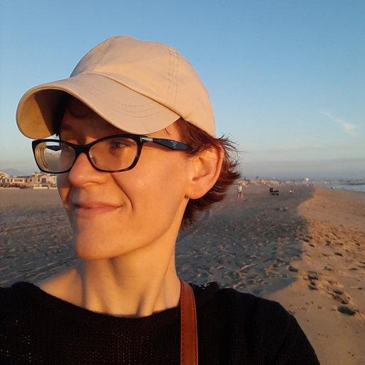
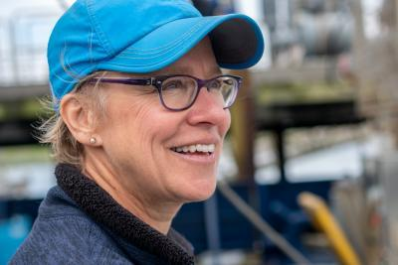
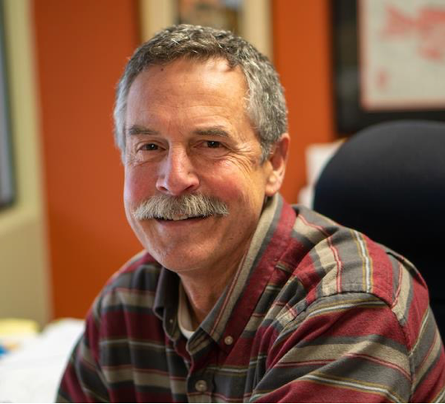
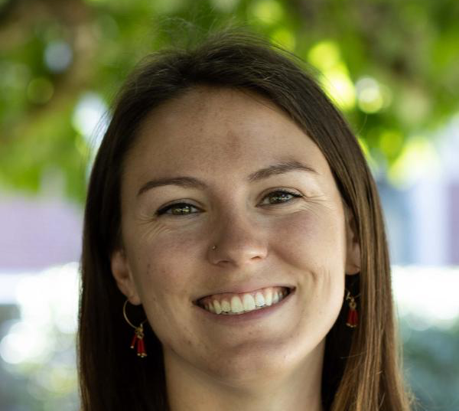
Our Objectives:
Objective 2: Understand risks and vulnerabilities of Dungeness crab and krill populations to change
Why do this? We don’t know what are the thresholds in stressors, alone or in combination, that will impair the productivity of Dungeness crab populations or forage food webs.
Nina Bednarsek
Su Sponaugle
Bob Cowen
Elena Conser
Nyazia
Sajdah-Bey

Slide 6
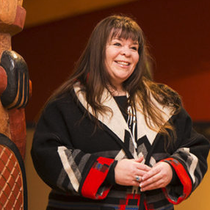
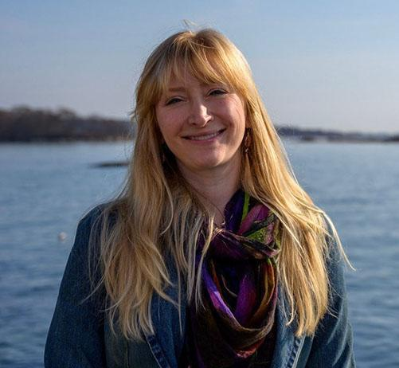
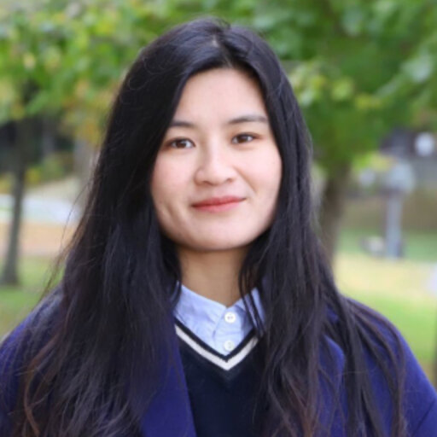
Our Objectives:
Objective 3: Predict what the future will hold
Why do this? Climate change will reshuffle stressors but current projections don’t take full advantage of our most advanced climate, circulation and ecosystem models. Our understanding of change and its consequences have also been largely siloed from those held by tribal and commercial fishing communities. This limits our understanding and confidence in when we will cross thresholds for harm and who will be most affected.
Samantha
Chisholm Hatfield
Samantha
Siedlecki
Yifan Zhu

Slide 7
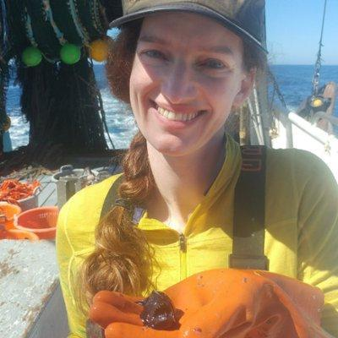
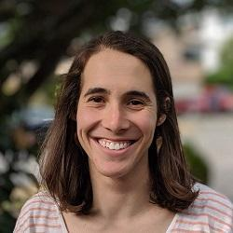
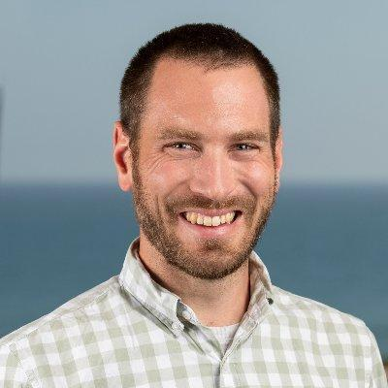
Our Objectives:
Objective 4: Co-develop climate-ready management options for the Dungeness crab fishery
Why do this? We need to translate new understanding of climate risks into useful options for people managing those risks.
Kate Richerson
Kiva Oken
Chris Free

Slide 8
Introduction of MTAG members:
Name
Affiliation
What is your favorite spot along the Pacific Northwest coast and why?

Slide 9
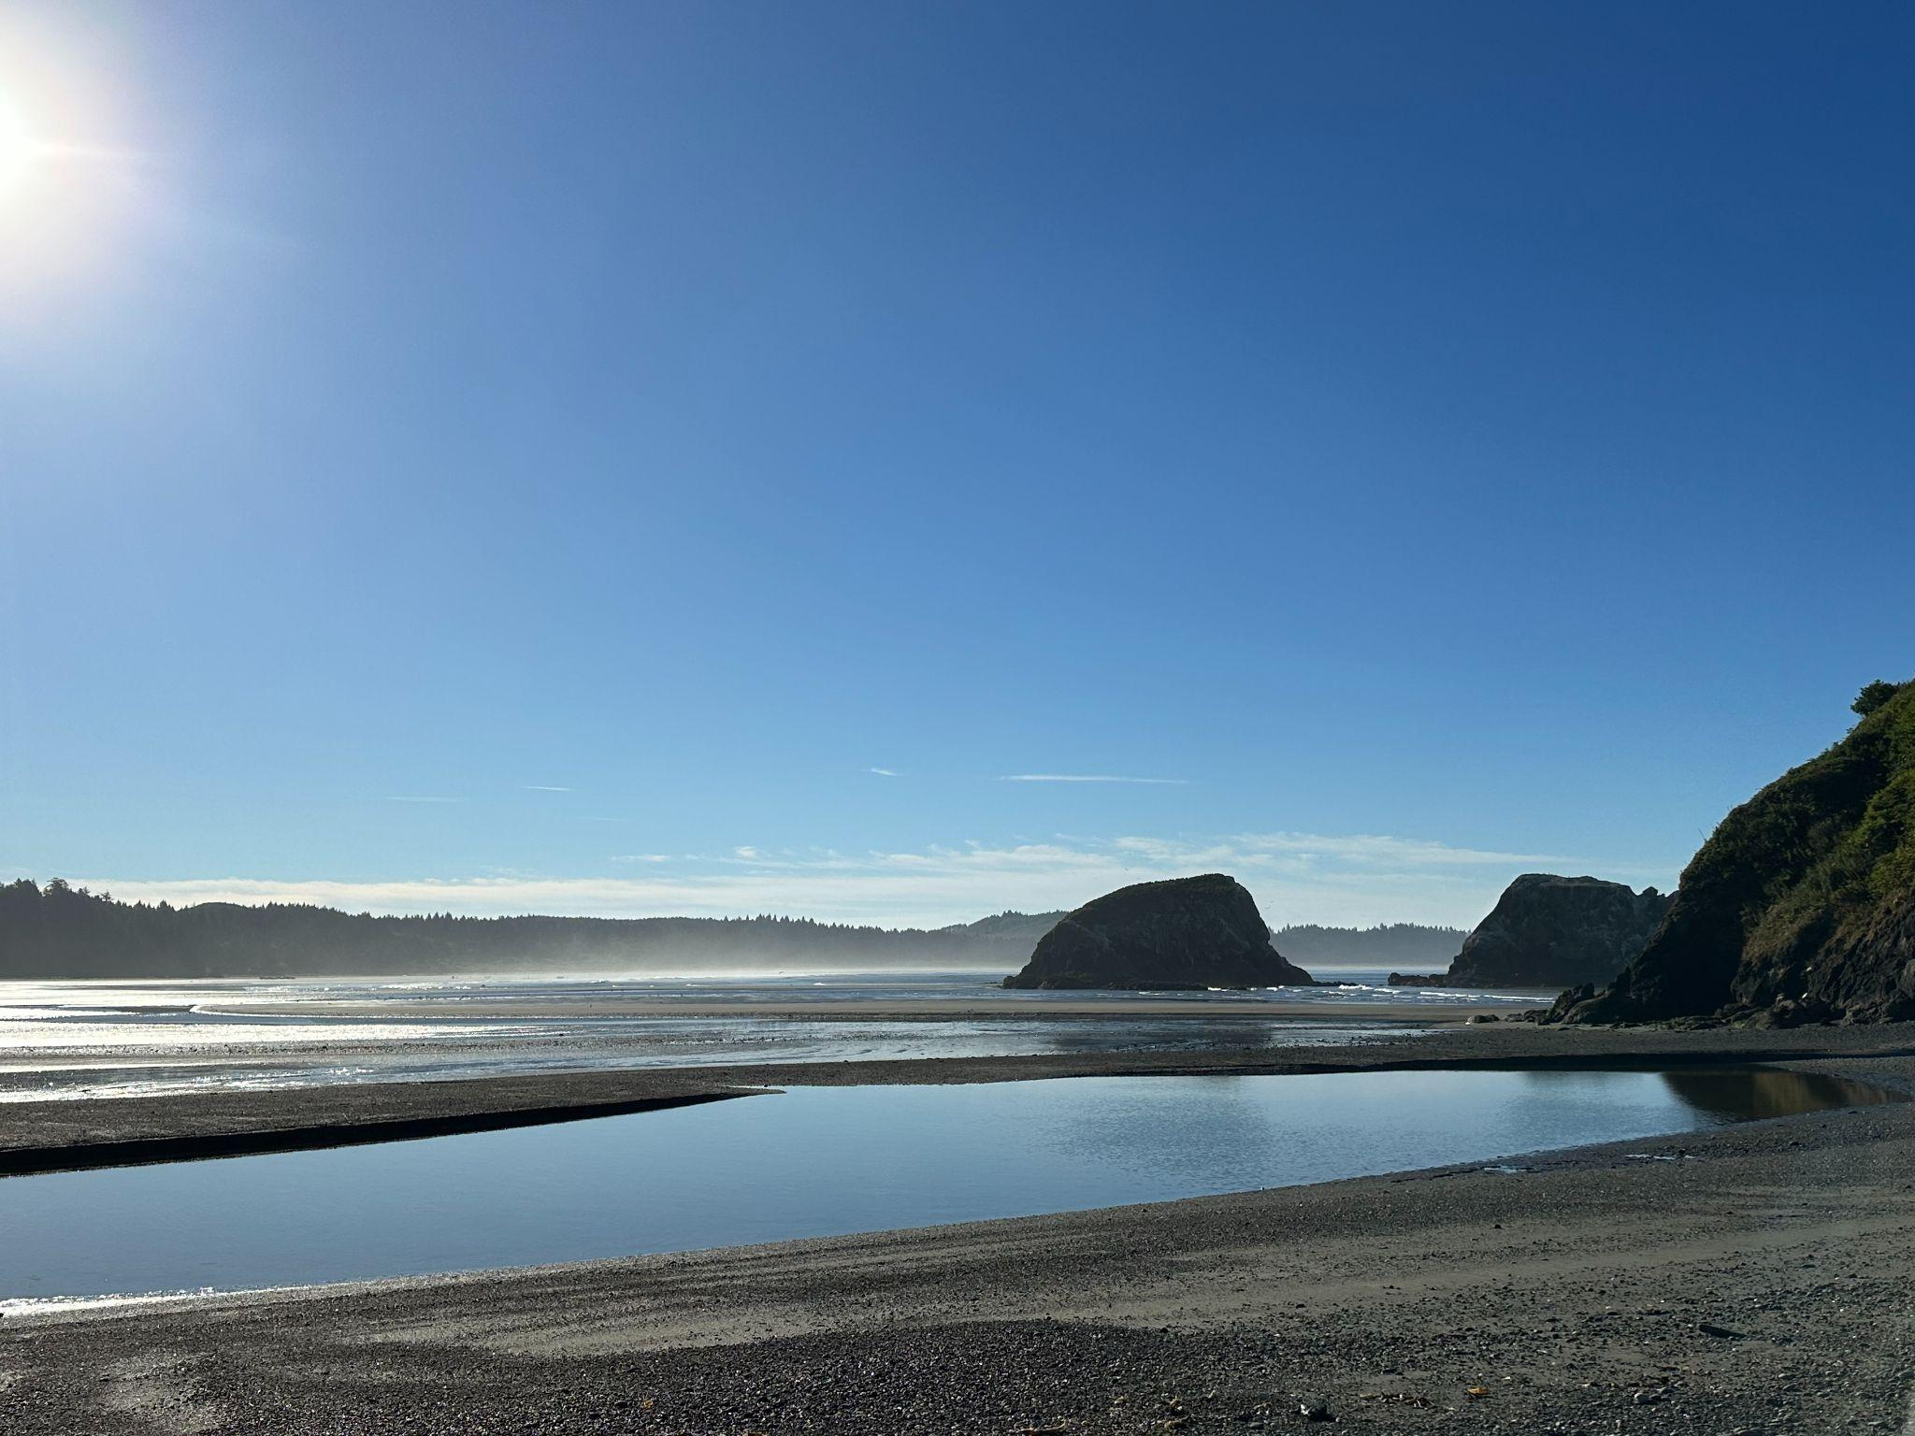
Building a shared vision for this project’s Management Transition Advisory Group

Slide 10
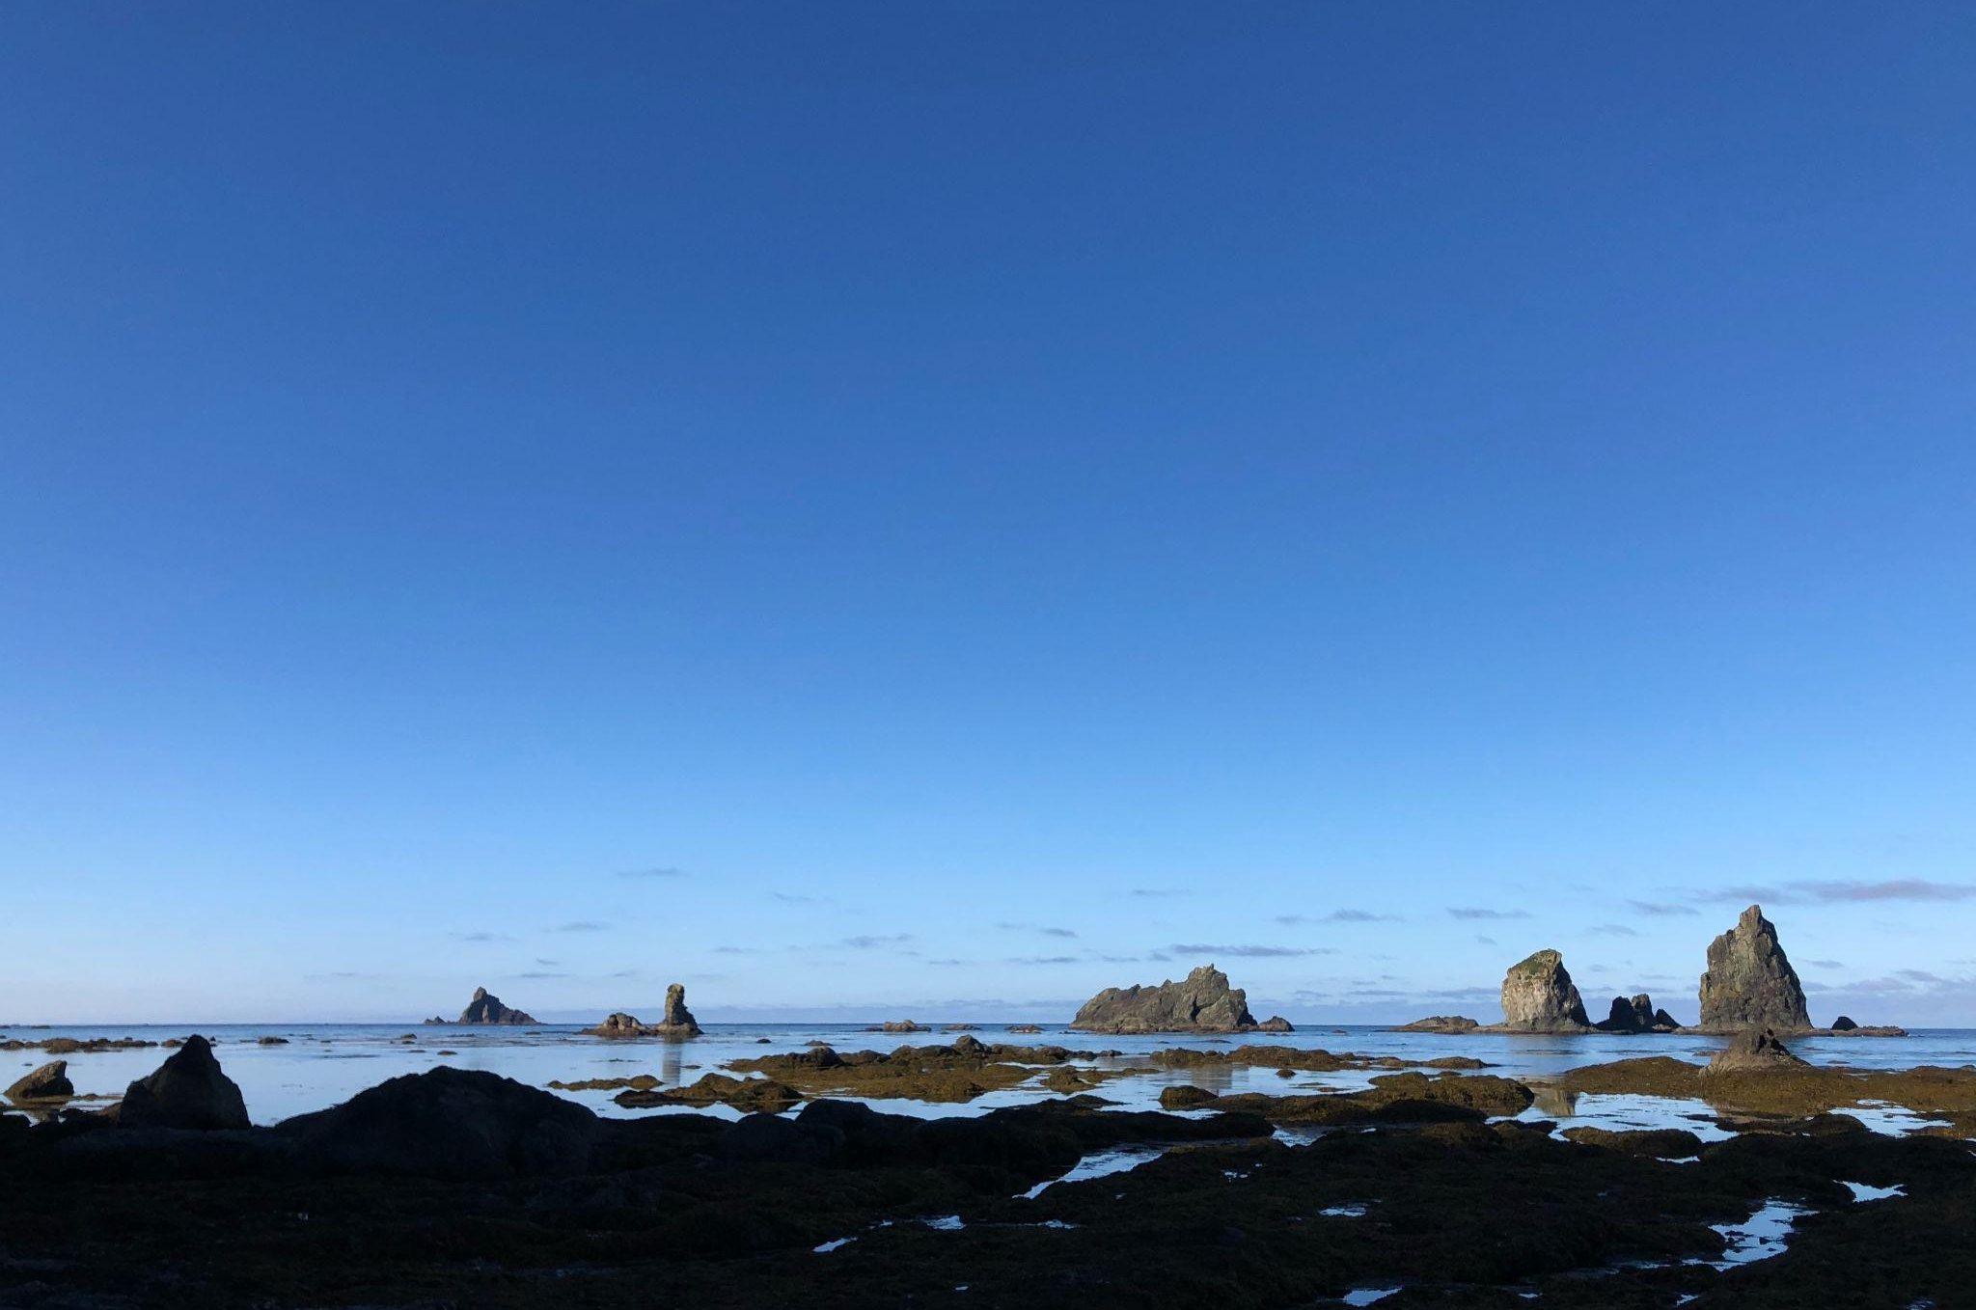
Proposed meeting schedule:
2024 - Virtual meeting plus in-person meeting, tentatively in Forks, WA
2025 - Two to three virtual meetings
2026 - In-person meeting, tentatively in Oregon, plus final virtual meeting to conclude project

Slide 11
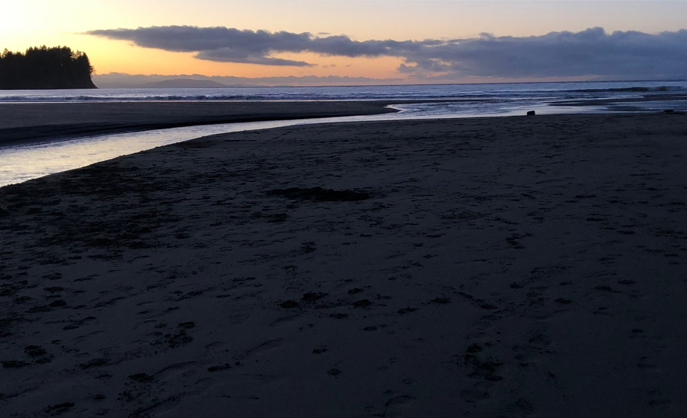
Ideas for Future Agenda Topics:
Overviews and updates for each of 4 project components
Tri-state crab management process, points of input
New electronic monitoring program implementation (WA)
Multi-stressor interactions: current and future conditions
Key science questions critical to resource managers
Special concerns of Tribal resource managers

Slide 12
Next Steps

