Slide 1
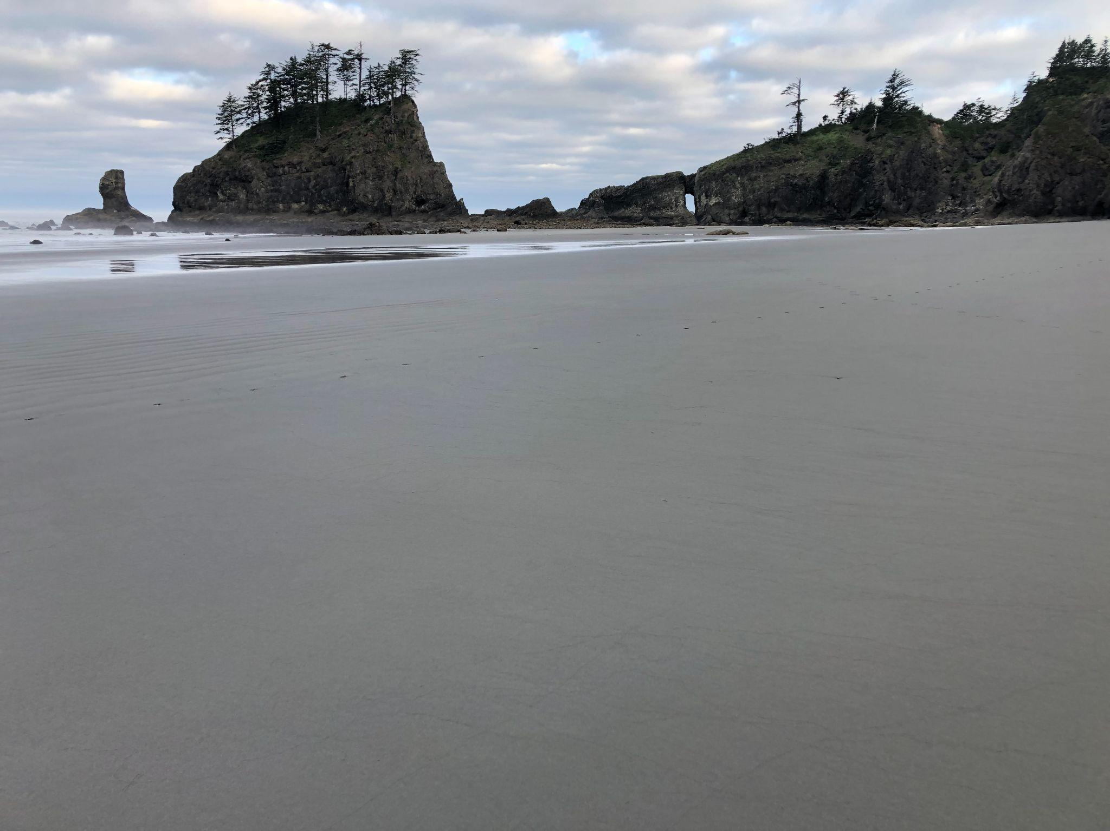
Management Transition Advisory Group for the PNW Multi-stressor Research Project
Virtual Meeting 2
3 April, 2024

Slide 2
Today: Update on what do we know about ocean acidification and hypoxia exposure in our region through time

Slide 3
First, a quick refresher on project objectives

Slide 4
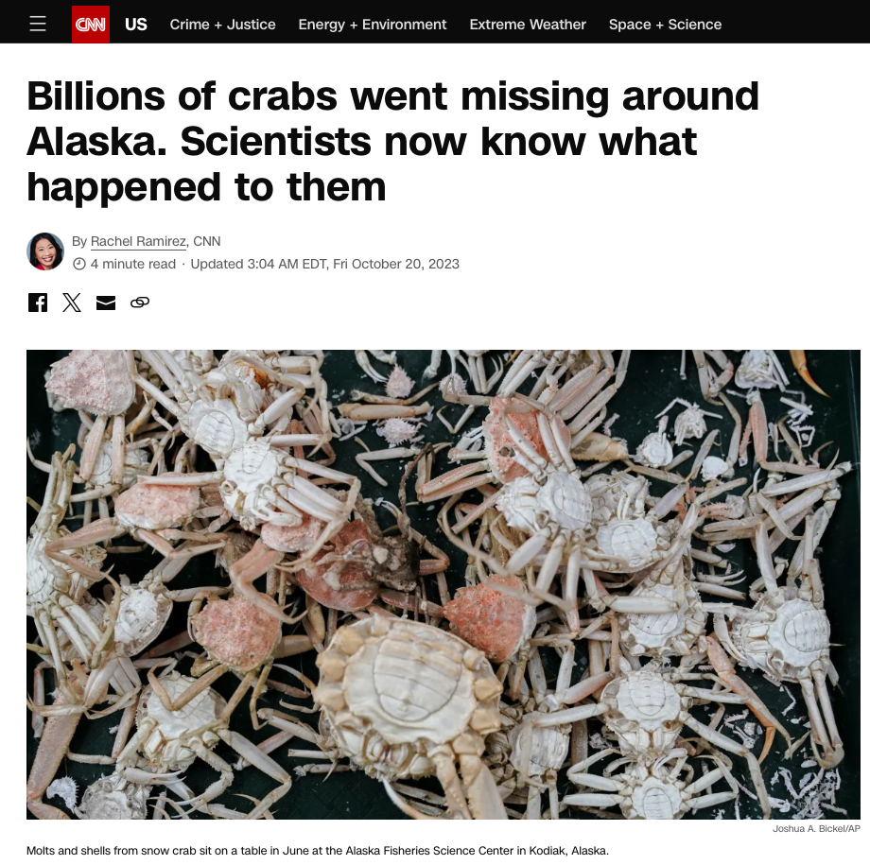
Can we avoid this?

Slide 5
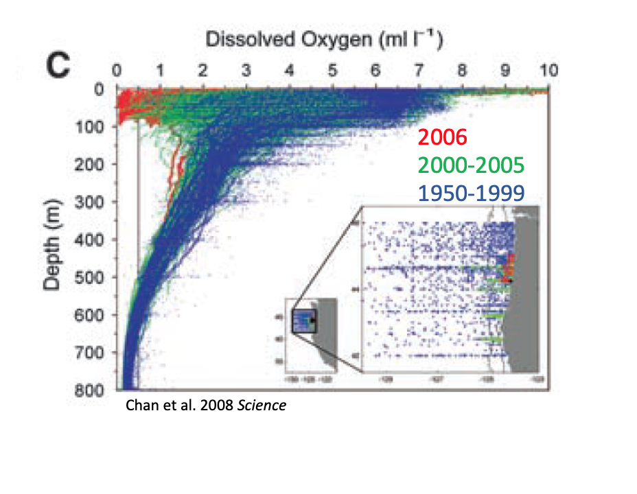
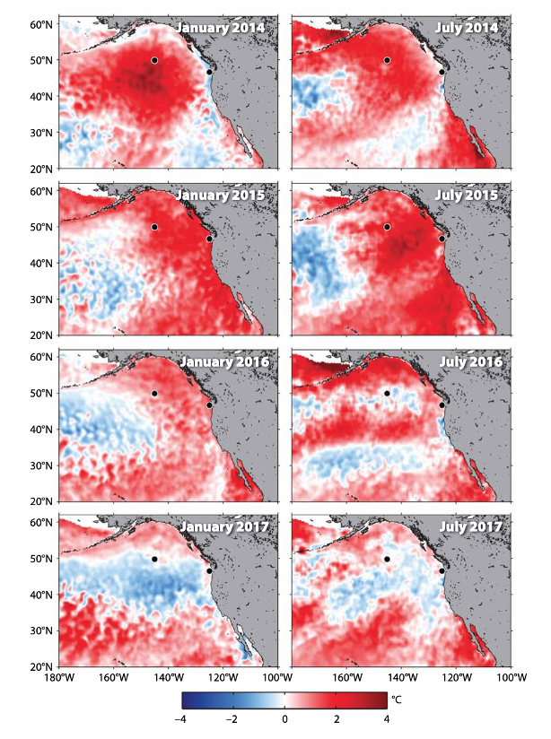
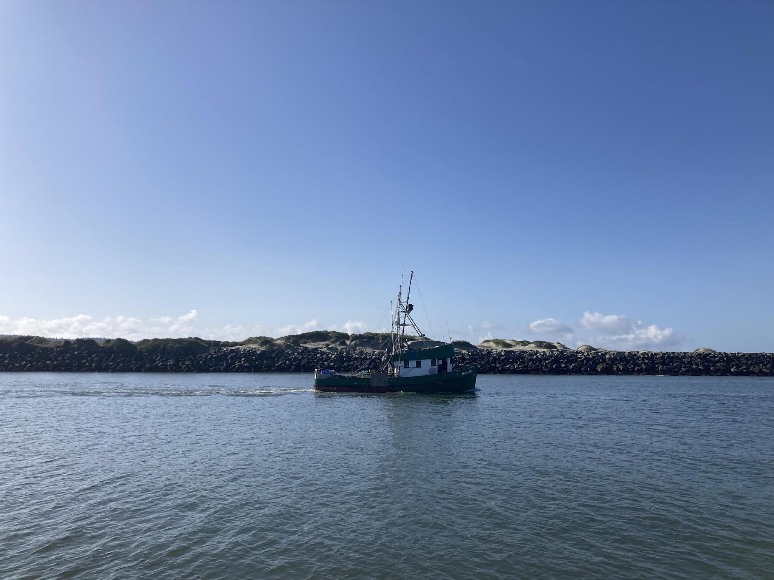
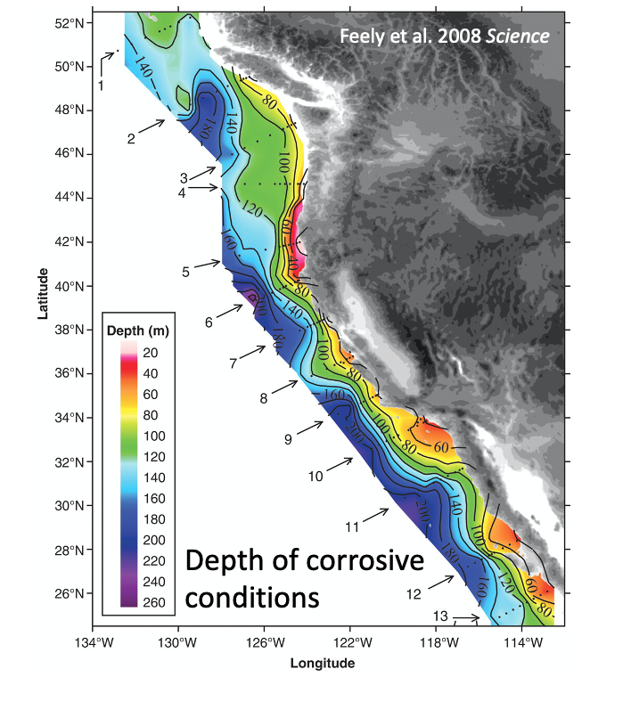
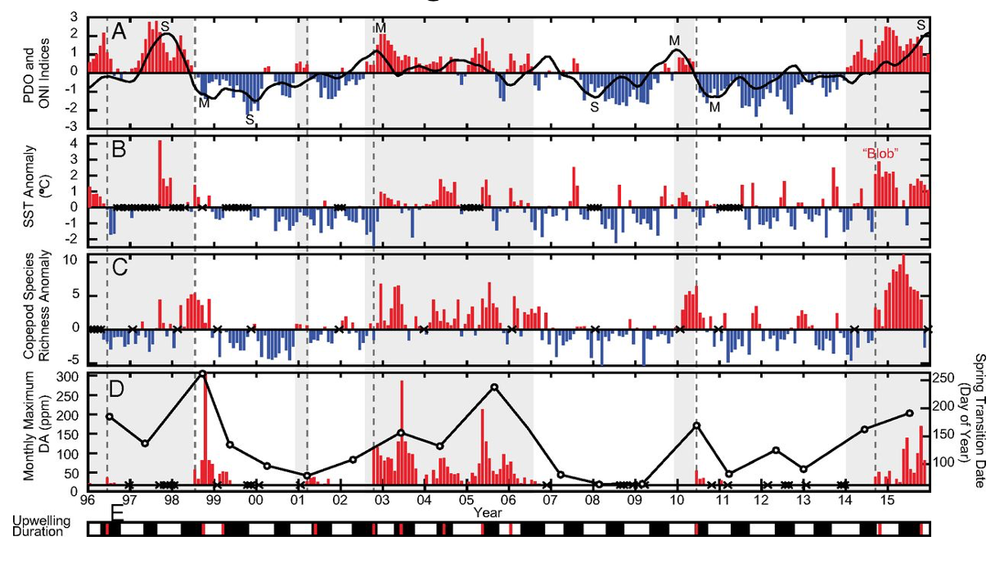
Multiple Stressors are landing together on our shores
hypoxia
marine heatwaves
ocean acidification
Harmful algal blooms
Can we put science to work?

Slide 6
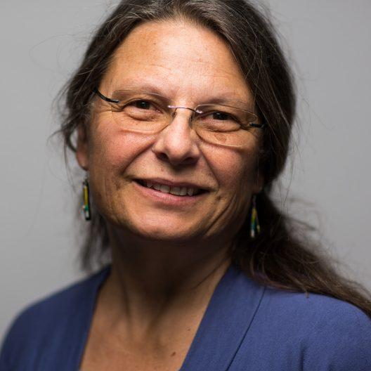
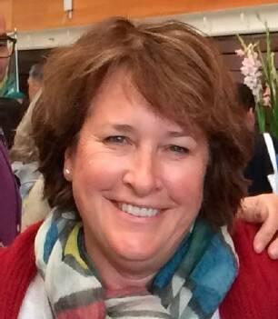
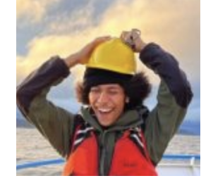
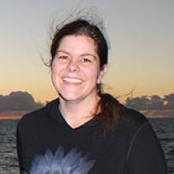
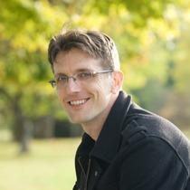
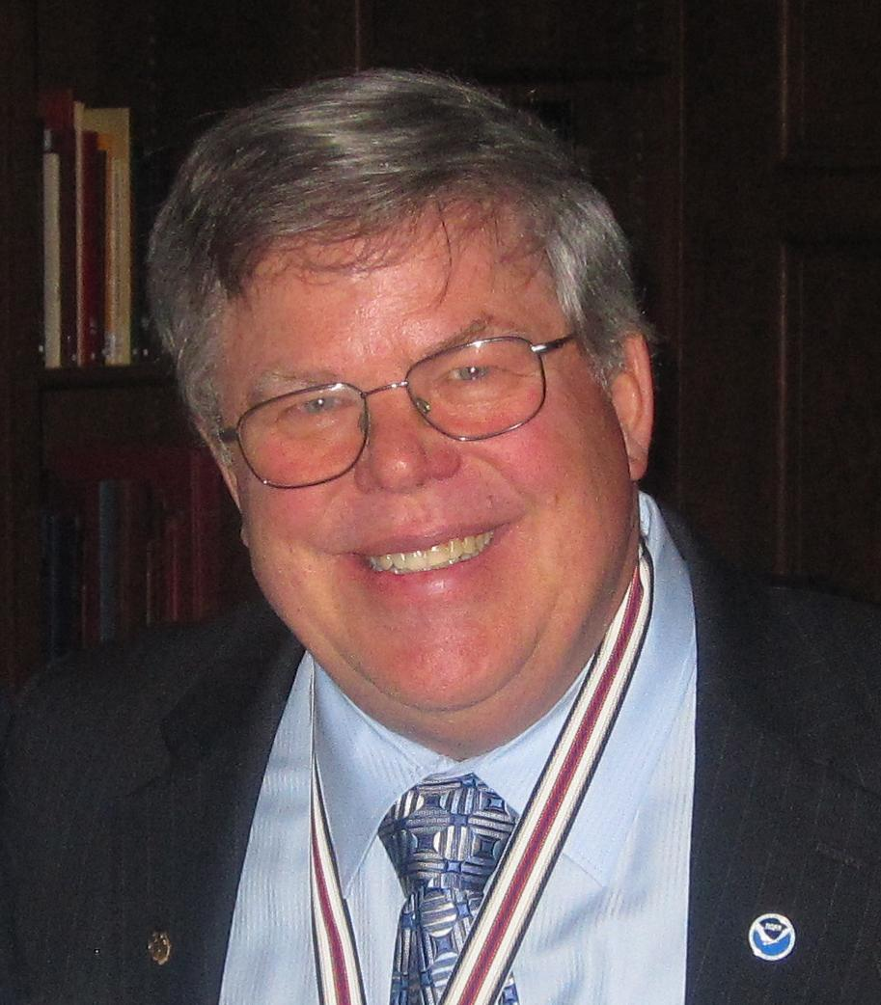
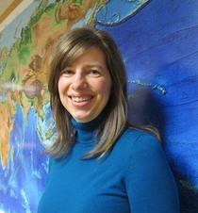
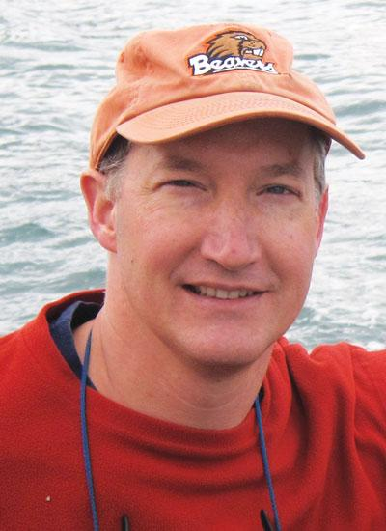
Our Objectives:
Objective 1: Construct a comprehensive synthesis of multi-stressor exposure in the nCCE
Why do this? We don’t have a complete picture of the risks we face -where, when and how severely OA, hypoxia, marine heatwaves, and HABs are affecting different parts of our coastal ocean.
Jan Newton
Vera Trainer
Christian Swift
Maria Kavanaugh
Brendan Carter
Dick Feely
Simone Alin
Jack Barth

Slide 7
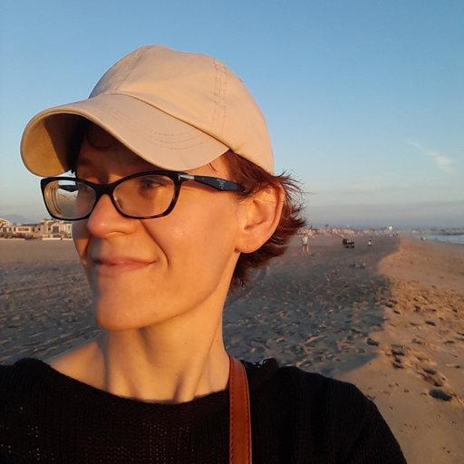
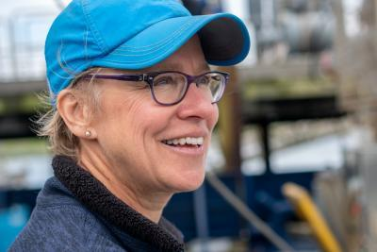
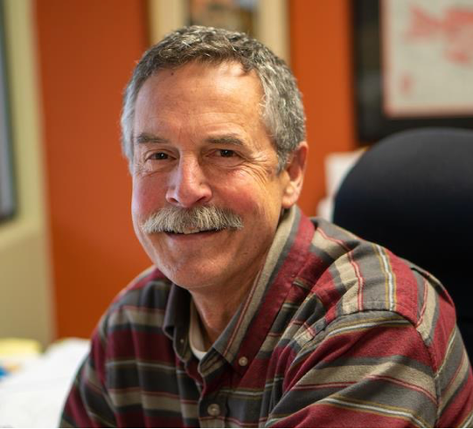
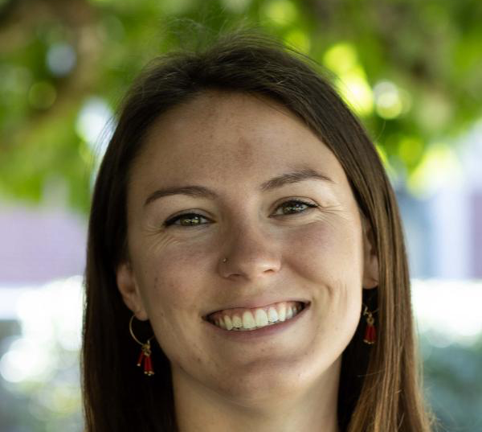
Our Objectives:
Objective 2: Understand risks and vulnerabilities of Dungeness crab and krill populations to change
Why do this? We don’t know what are the thresholds in stressors, alone or in combination, that will impair the productivity of Dungeness crab populations or forage food webs.
Nina Bednarsek
Su Sponaugle
Bob Cowen
Elena Conser
Nyazia
Sajdah-Bey

Slide 8
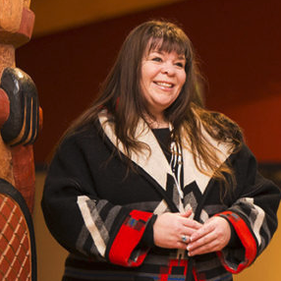
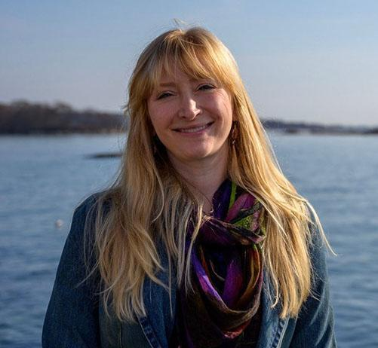
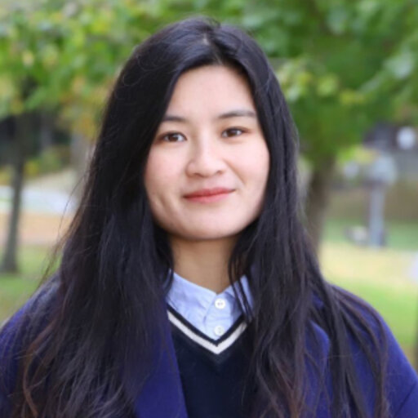
Our Objectives:
Objective 3: Predict what the future will hold
Why do this? Climate change will reshuffle stressors but current projections don’t take full advantage of our most advanced climate, circulation and ecosystem models. Our understanding of change and its consequences have also been largely siloed from those held by tribal and commercial fishing communities. This limits our understanding and confidence in when we will cross thresholds for harm and who will be most affected.
Samantha
Chisholm Hatfield
Samantha
Siedlecki
Yifan Zhu

Slide 9
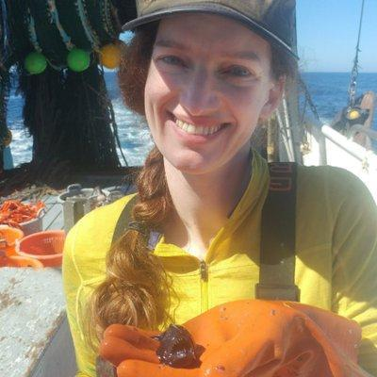
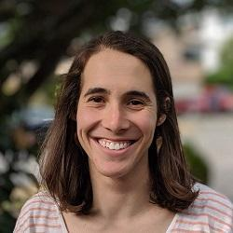
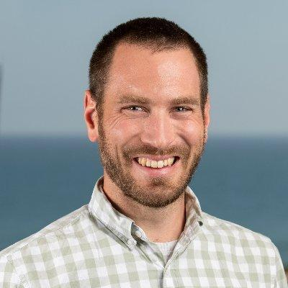
Our Objectives:
Objective 4: Co-develop climate-ready management options for the Dungeness crab fishery
Why do this? We need to translate new understanding of climate risks into useful options for people managing those risks.
Kate Richerson
Kiva Oken
Chris Free

Slide 10
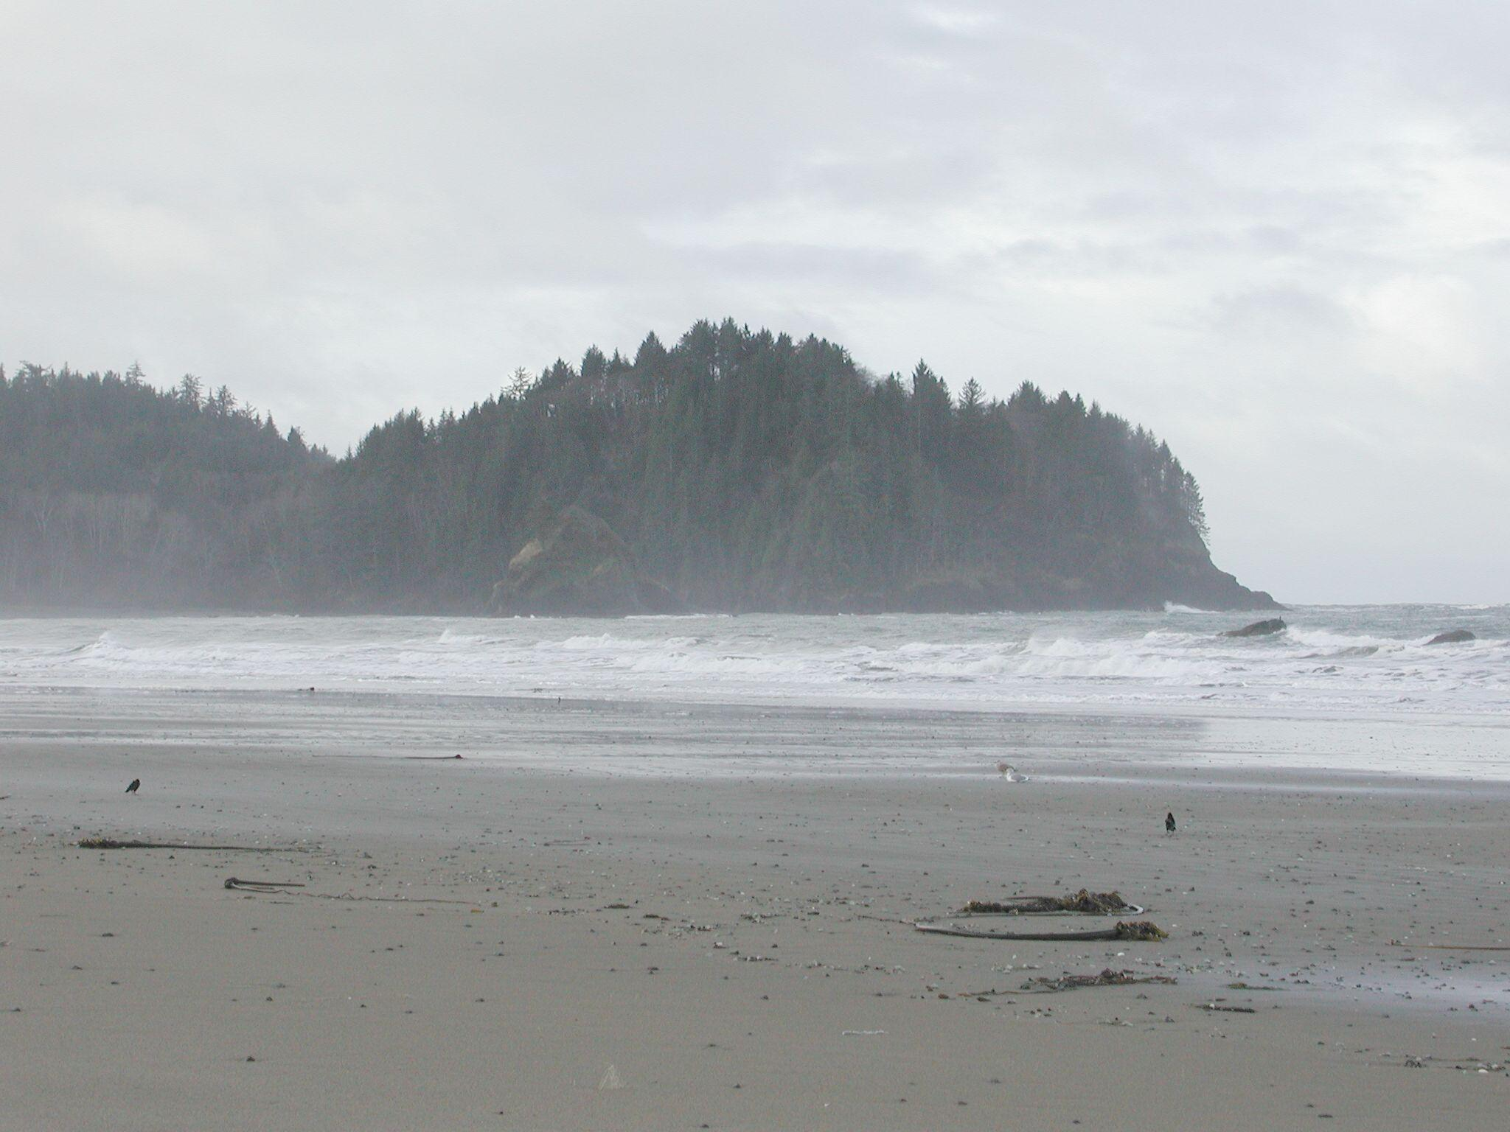
Harmful algal bloom research Multistressor Project
Vera L. Trainer, Ph.D.
Marine Program Director
Olympic Natural Resources Center

Slide 11
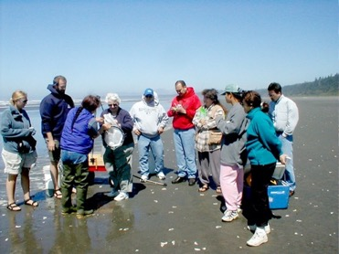
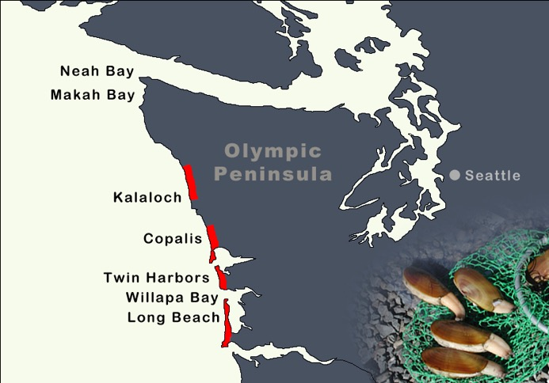
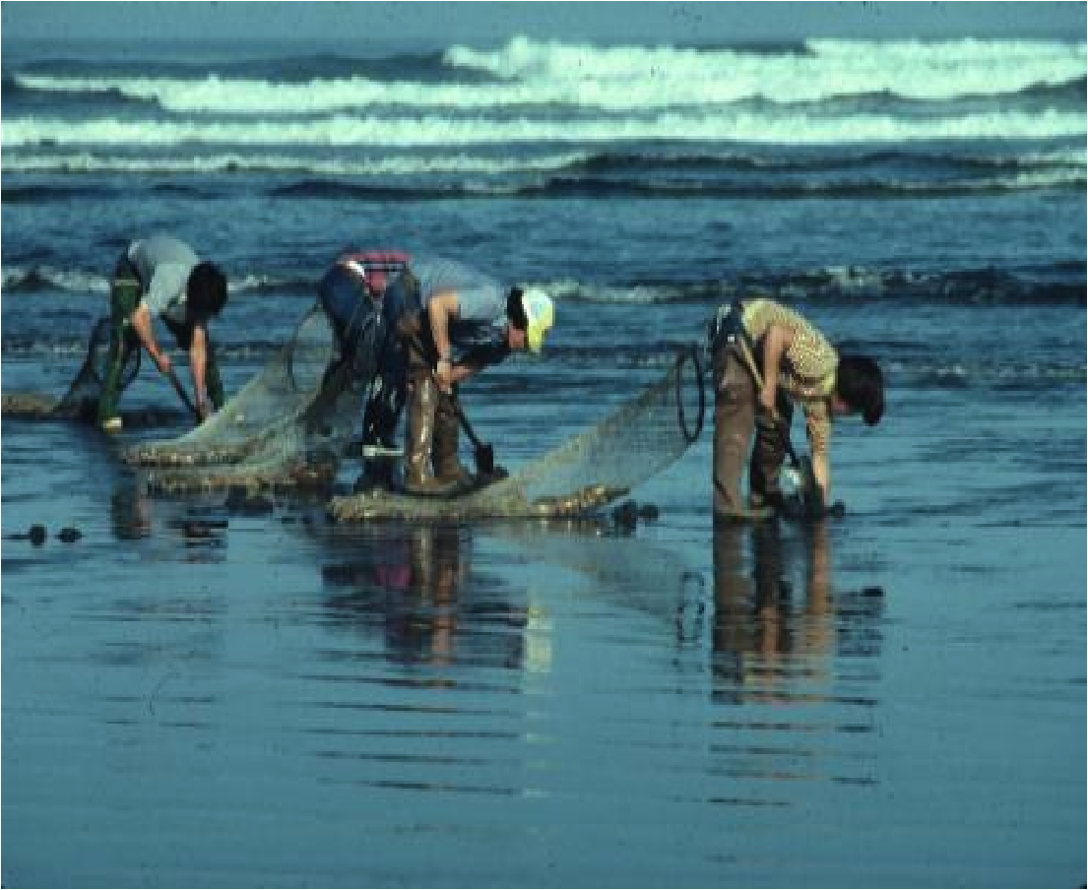
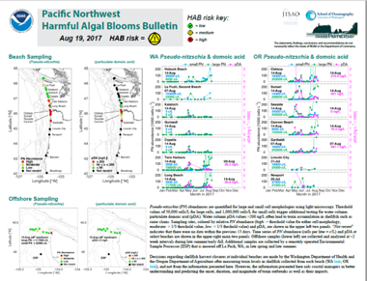
Olympic Region Harmful Algal Bloom partnership
ORHAB partners
ONRC (Lead)
Quileute, Quinault, Makah, Hoh tribes
State agencies: WDFW, WDOH
Federal agencies: NANOOS, OCNMS
WA State funding - House Bill 1620 established in 2003 with a tax to shellfish license fees
ORHAB training class
tribal members digging clams
ORHAB sampling sites
Pacific Northwest HAB Bulletin
Notes:
The Olympic Region Harmful Algal Bloom (ORHAB) is a diverse partnership among federal, state, tribal and local management and research agencies, marine resource-based businesses, and academic institutions. It has a long-standing philosophy of collaboration and recognition of all partners who have equal voices. It is one of the only projects initially funded by the Federal government that successfully transitioned to State funding - $2 dollars from each razor clam license sales helps fund ORHAB.

Slide 12
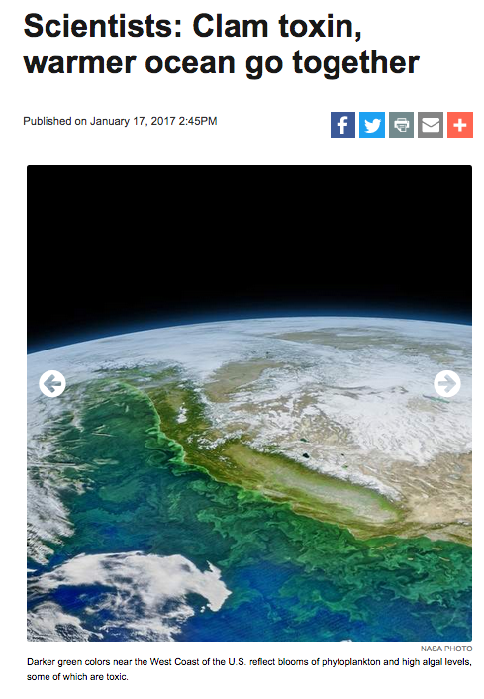
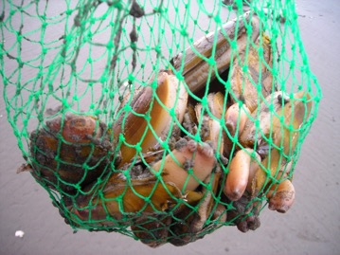
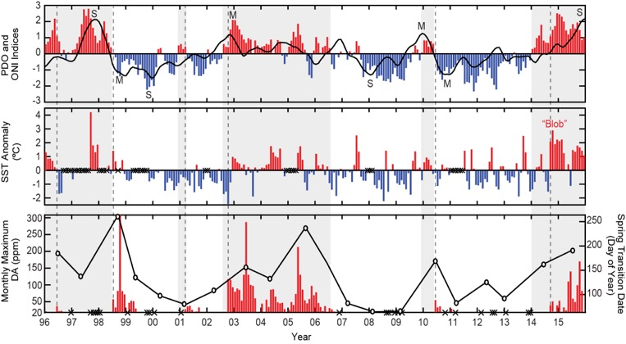
Seasonal forecast: Pseudo-nitzschia blooms (HABs) are correlated with ocean warming
Linkage to warm ocean conditions (Climate Change)
Shellfish closures in OR
Climate index
Temperature
McKibben et al. 2017. PNAS
Notes:
Temperature is a strong indicator of the most toxigenic Pseudo-nitzschia blooms. Most shellfish closures occur during or immediately following the warmest events – El Nino or Blob. The records of HAB occurrence are now long enough to begin developing long-term forecasts.

Slide 13
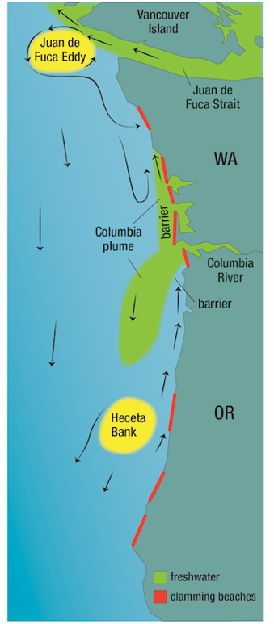
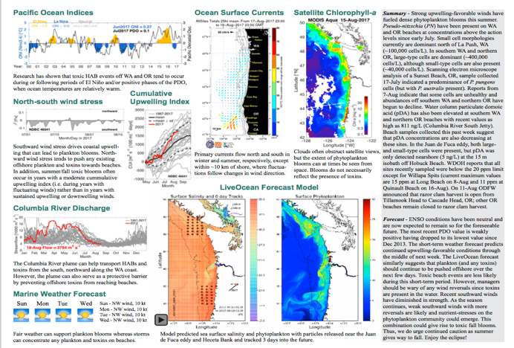
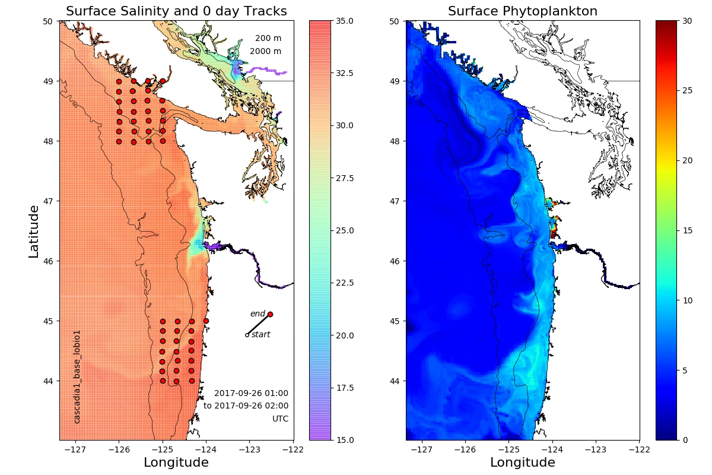
Improve Predictability of Harmful Algal Blooms
Data integration & interpretation:
Toxin & cell monitoring at coast
Offshore boat sampling at hotspots
Weather predictions
Models (cell transport & Columbia River plume)
Climate change indicators
Facilitates management decisions:
Selective harvest at safe locations
Pre-emptive increase in harvest limit
Matt Hunter (ODFW) testimonial (May 2017) – “The Long Beach, Washington razor clam opening and increased bag limit was a boon for OR north coast economies as well. Astoria businesses sold a lot of digging equipment. A lot of people were hungry for clams”
Pacific Northwest HAB BULLETIN
Pacific Northwest HAB Bulletins
www.nanoos.org/products/habs/
www.orhab.org
Notes:
This is being financed through NOAA extramural research

Slide 14
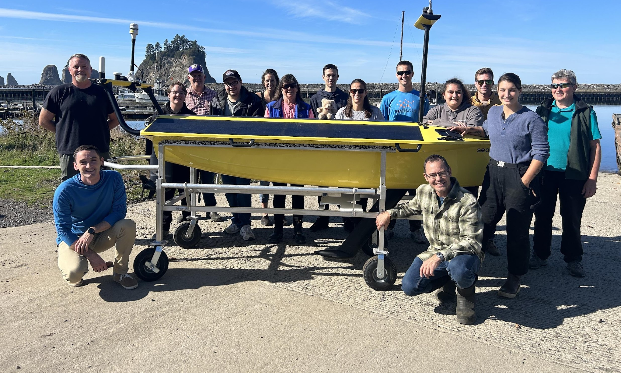
Autonomous vehicle deployment for HAB sampling
AUV deployed as a platform for taking water samples for HAB organisms
Joint NANOOS, ORHAB. and SeaSats project
Collecting water samples and associated data
Samples to be analyzed at ONRC and tribal labs.
X

Slide 15
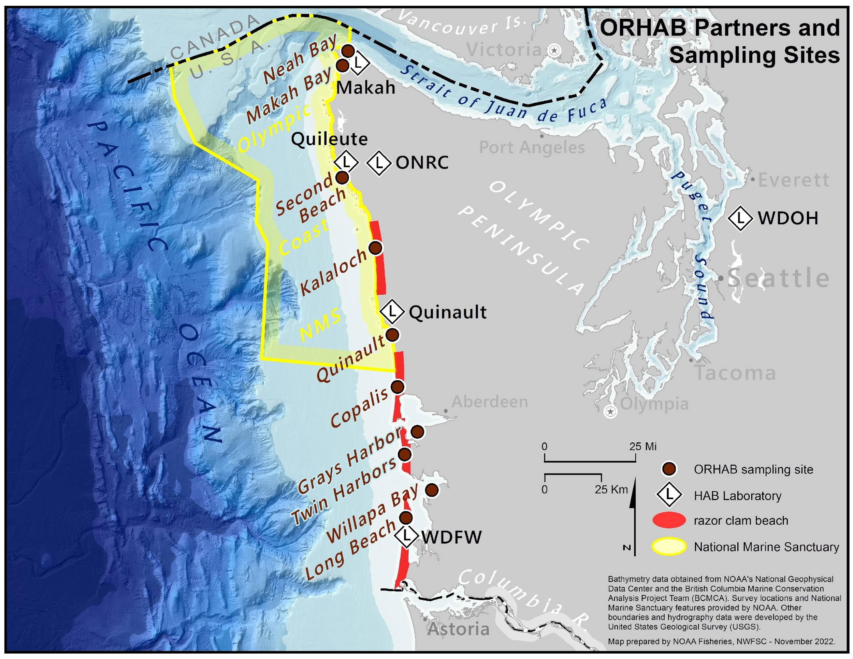
Hoh

Slide 16
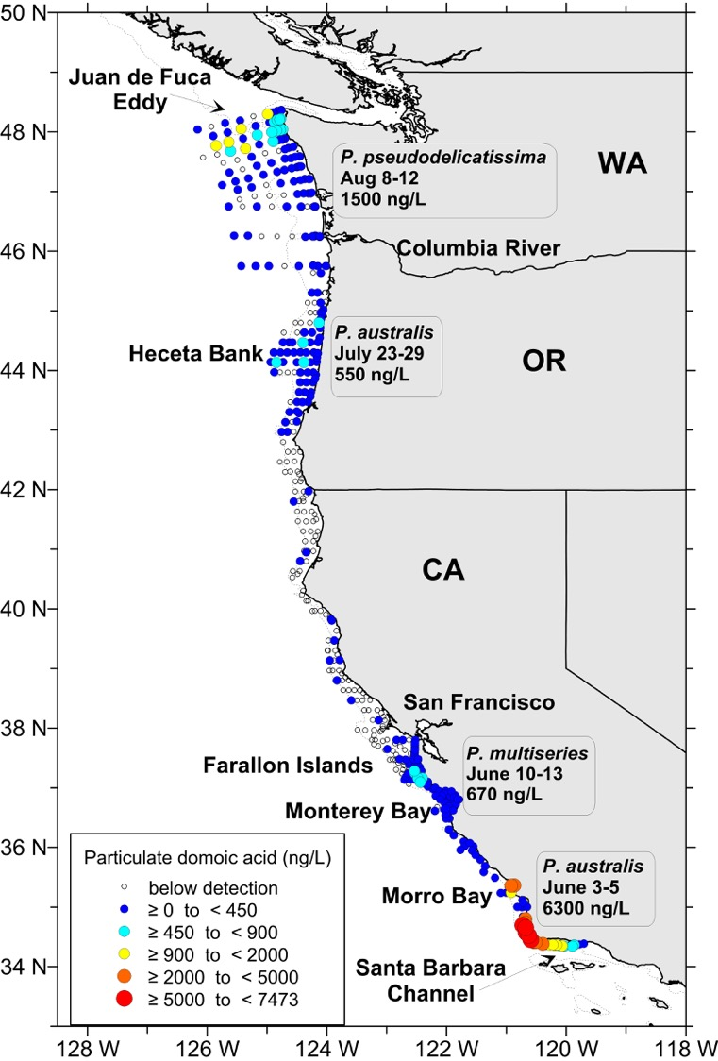
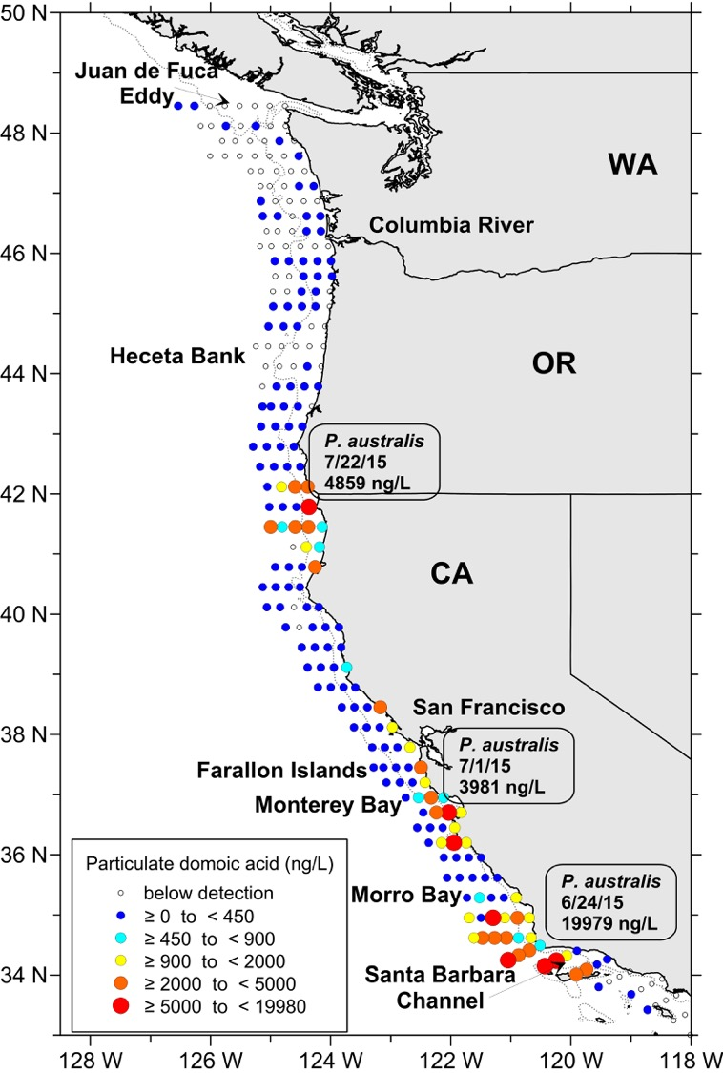
Evidence of the new domoic acid ”hotspot” site established in 2015 after “the Blob”
1998
2015

Slide 17
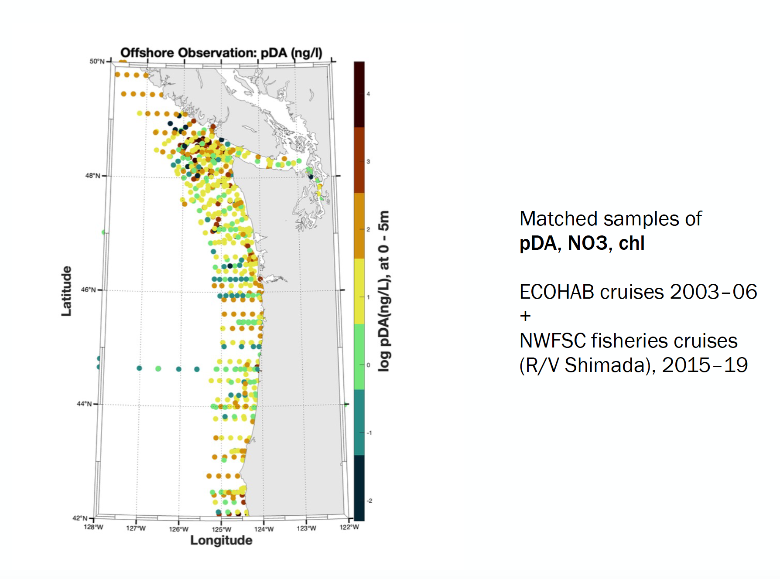
Efforts to Model HABs
Neil Banas, Paul Udom, Hally Stone
U. Strathclyde & UW

Slide 18
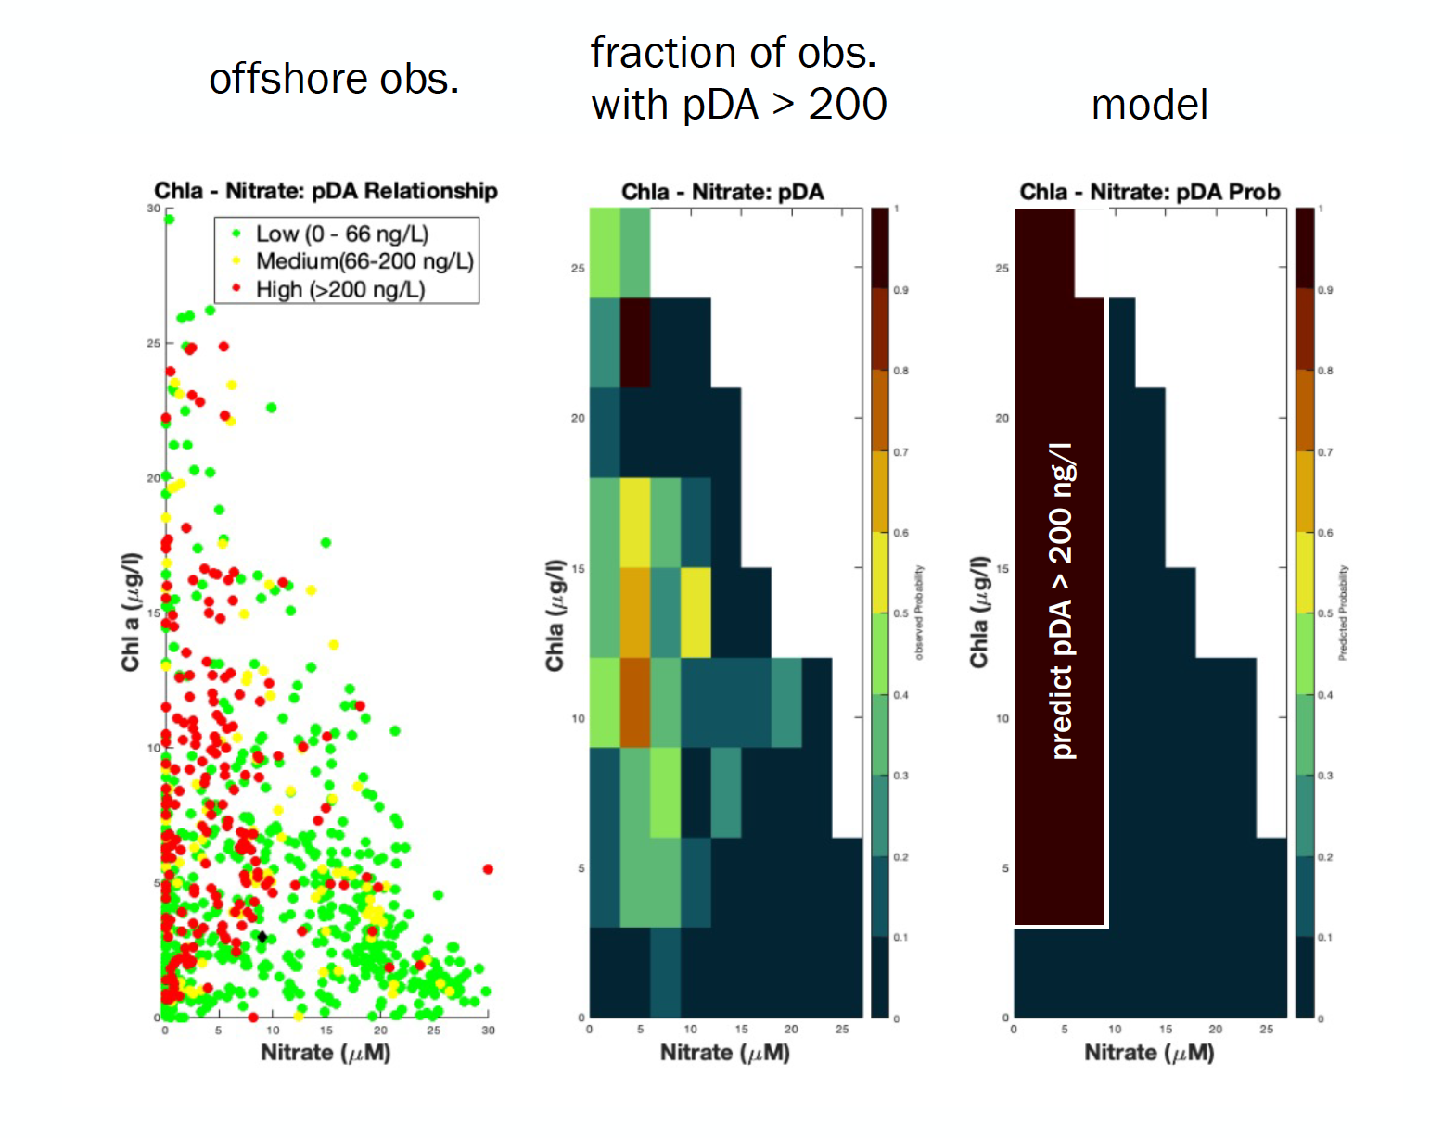
PN and pDA will accumulate offshore when chl is moderate/high by nitrate is low

Slide 19
Modeling efforts for Multistressor project
Bringing all the puzzle pieces together

Slide 20
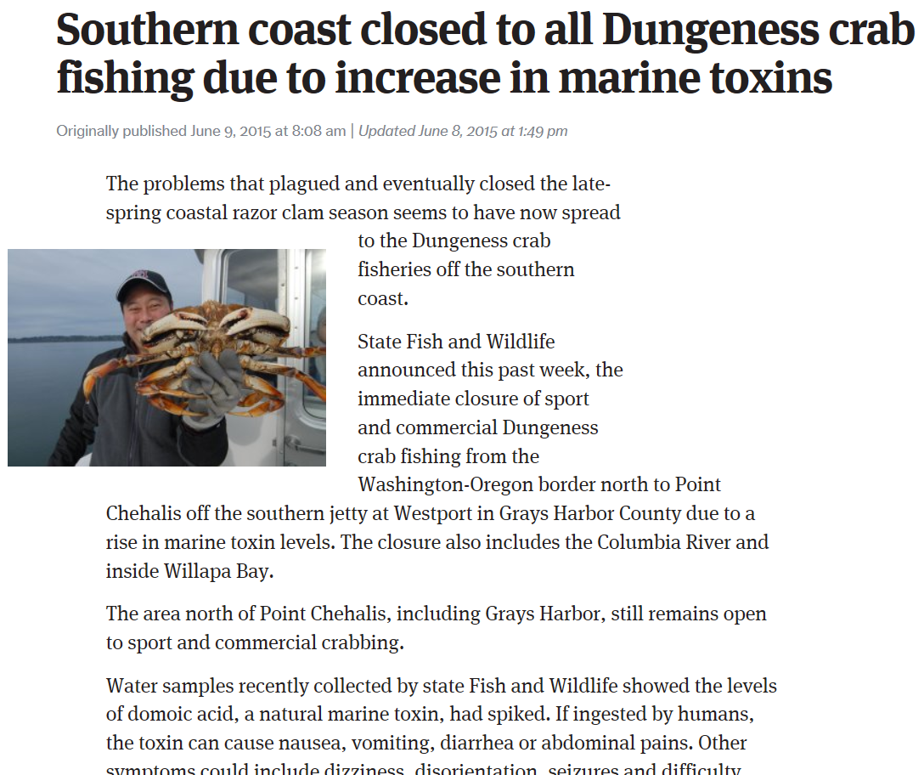
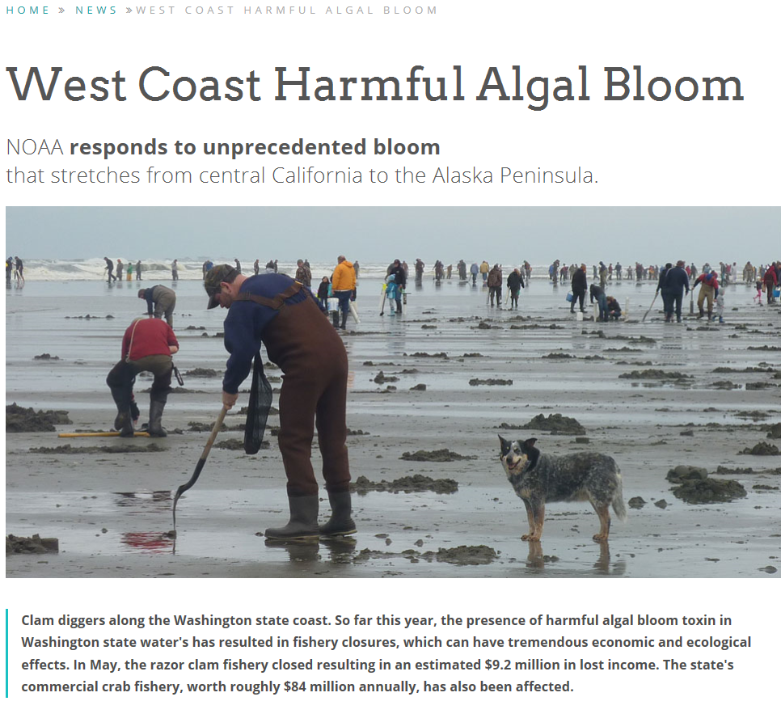

Slide 21
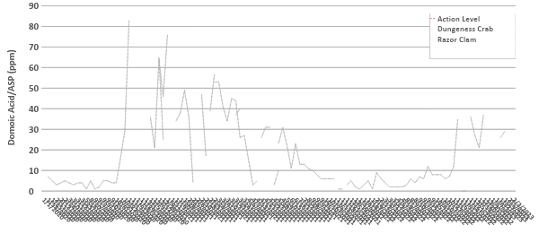
Long Beach Peninsula ASP/Domoic Acid

Slide 22
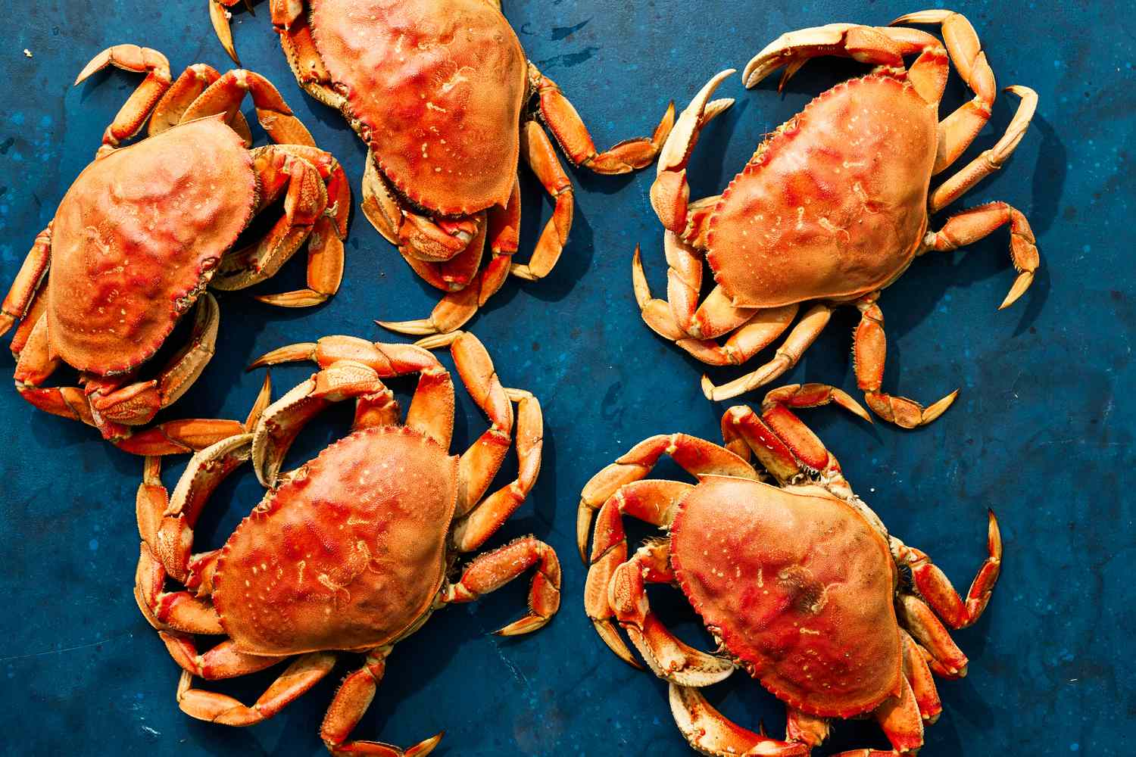
Crab Bill
HB 1010 - 2023-24

Slide 23
Crab Bill
Would give WA State control of Dungeness crab
Give CLEAR thresholds for:
Closure
Opening
Opening with restriction (i.e. evisceration)
Harvest, recall, and tracing of crab
Already existing rule for molluscan bivalves. DOH can structure similarly, but not exactly the same
Rulemaking would involve Stakeholder and Tribal input

Slide 24
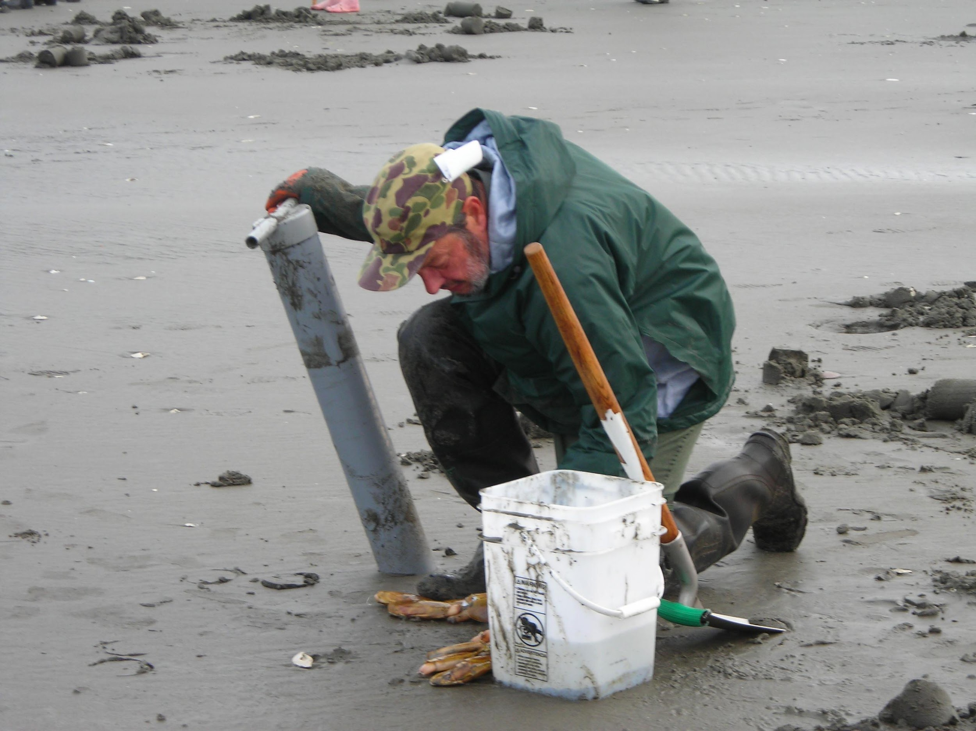
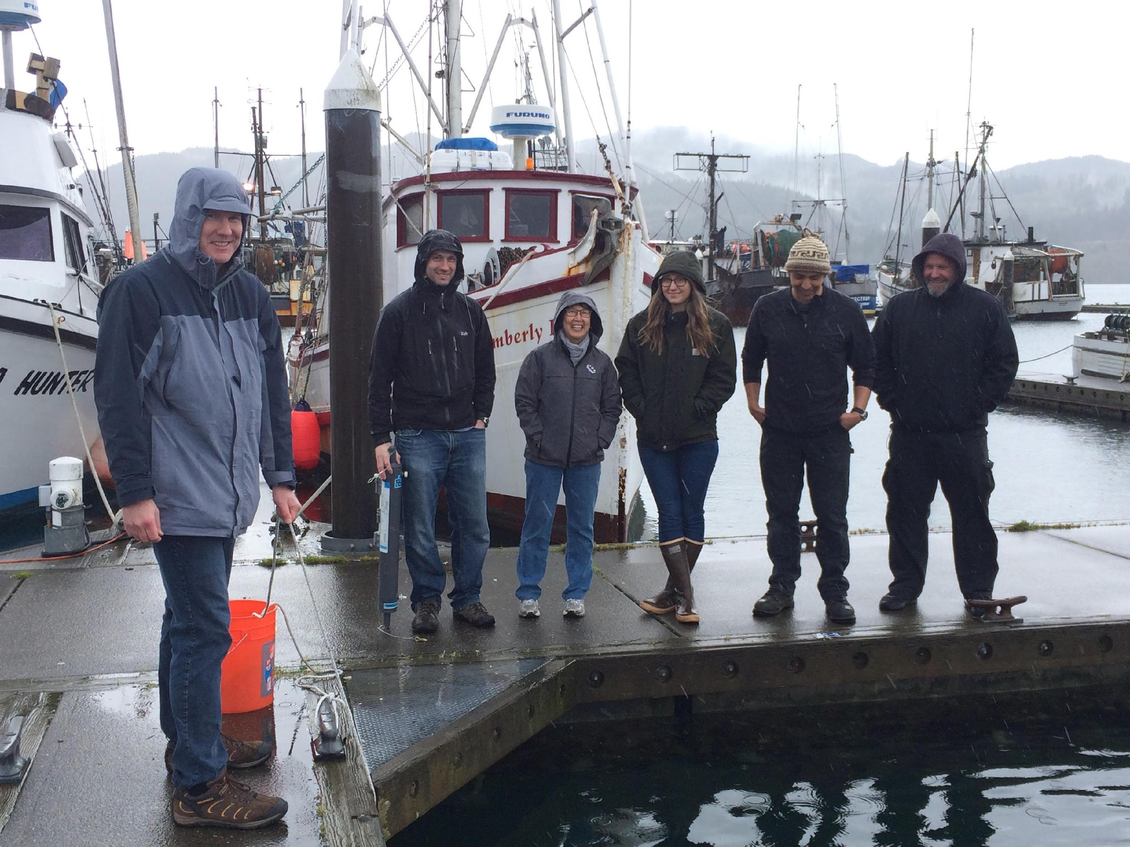
Acknowledgements
Vera Trainer
verat@uw.edu

Slide 25
Project Component/Objective:
Objective 1: Construct a comprehensive synthesis of multi-stressor exposure in the nCCE
Important steps:
Current challenges:
Jan Newton
Vera Trainer
Christian Swift
Maria Kavanaugh
Brendan Carter
Dick Feely
Simone Alin
Jack Barth

Slide 26
Project Component/Objective:
Objective 2: Understand risks and vulnerabilities of Dungeness crab and krill populations to change
Important steps:
Current challenges:
Nina Bednarsek
Su Sponaugle
Bob Cowen
Elena Conser
Nyazia
Sajdah-Bey

Slide 27
Project Component/Objective:
Objective 3: Predict what the future will hold
Important steps:
Current challenges:
Samantha
Chisholm Hatfield
Samantha
Siedlecki
Yifan Zhu

Slide 28
Project Component/Objective:
Objective 4: Co-develop climate-ready management options for the Dungeness crab fishery
Important steps:
Current challenges:
Kate Richerson
Kiva Oken
Chris Free

Slide 29
Project Component/Objective:
Project Management: Project planning, oversight and coordination, engagement of MTAG, reporting
Important steps:
Current challenges:
Replace photo
Add Jenny? Vera?
Francis Chan
Dick Feely

Slide 30
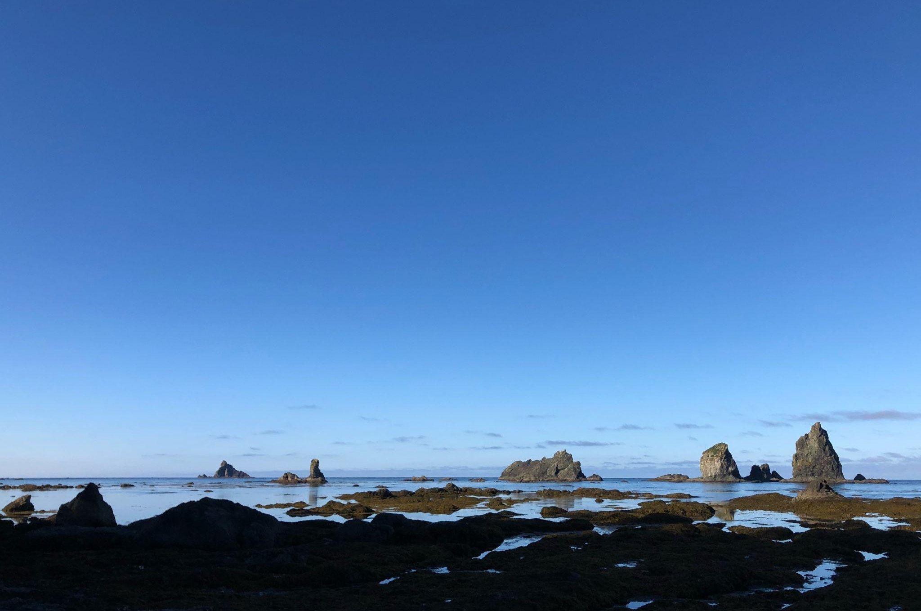
Proposed agenda for In-person meeting 29-30 April:
Dinner on evening of 29 April @ ONRC
~9:30-10am to 5pm on 30 April (breakfast, lunch and snacks)
Reverse approach to start with detailed discussion of MSE, given high relevance for MTAG
Discuss how each project element feeds into MSE
Dinner on evening of 30 April @ ONRC
Field trip to La Push in the morning or for sunset on 30th?

Slide 31
Proposed agenda for In-person meeting 30 April:
Morning session to focus on MTAG perspectives, concerns, emerging issues (would MTAG members like to present?)
Dig into details of Management Strategy Evaluation
Discuss details of project elements, synergies, and how they inform the MSE; review of anticipated outputs, outcomes
MTAG feedback on project management and communications, use of virtual and in-person meetings, desired resources, opportunities to engage with Tri-state crab management, what’s working, key questions, etc.

Slide 32
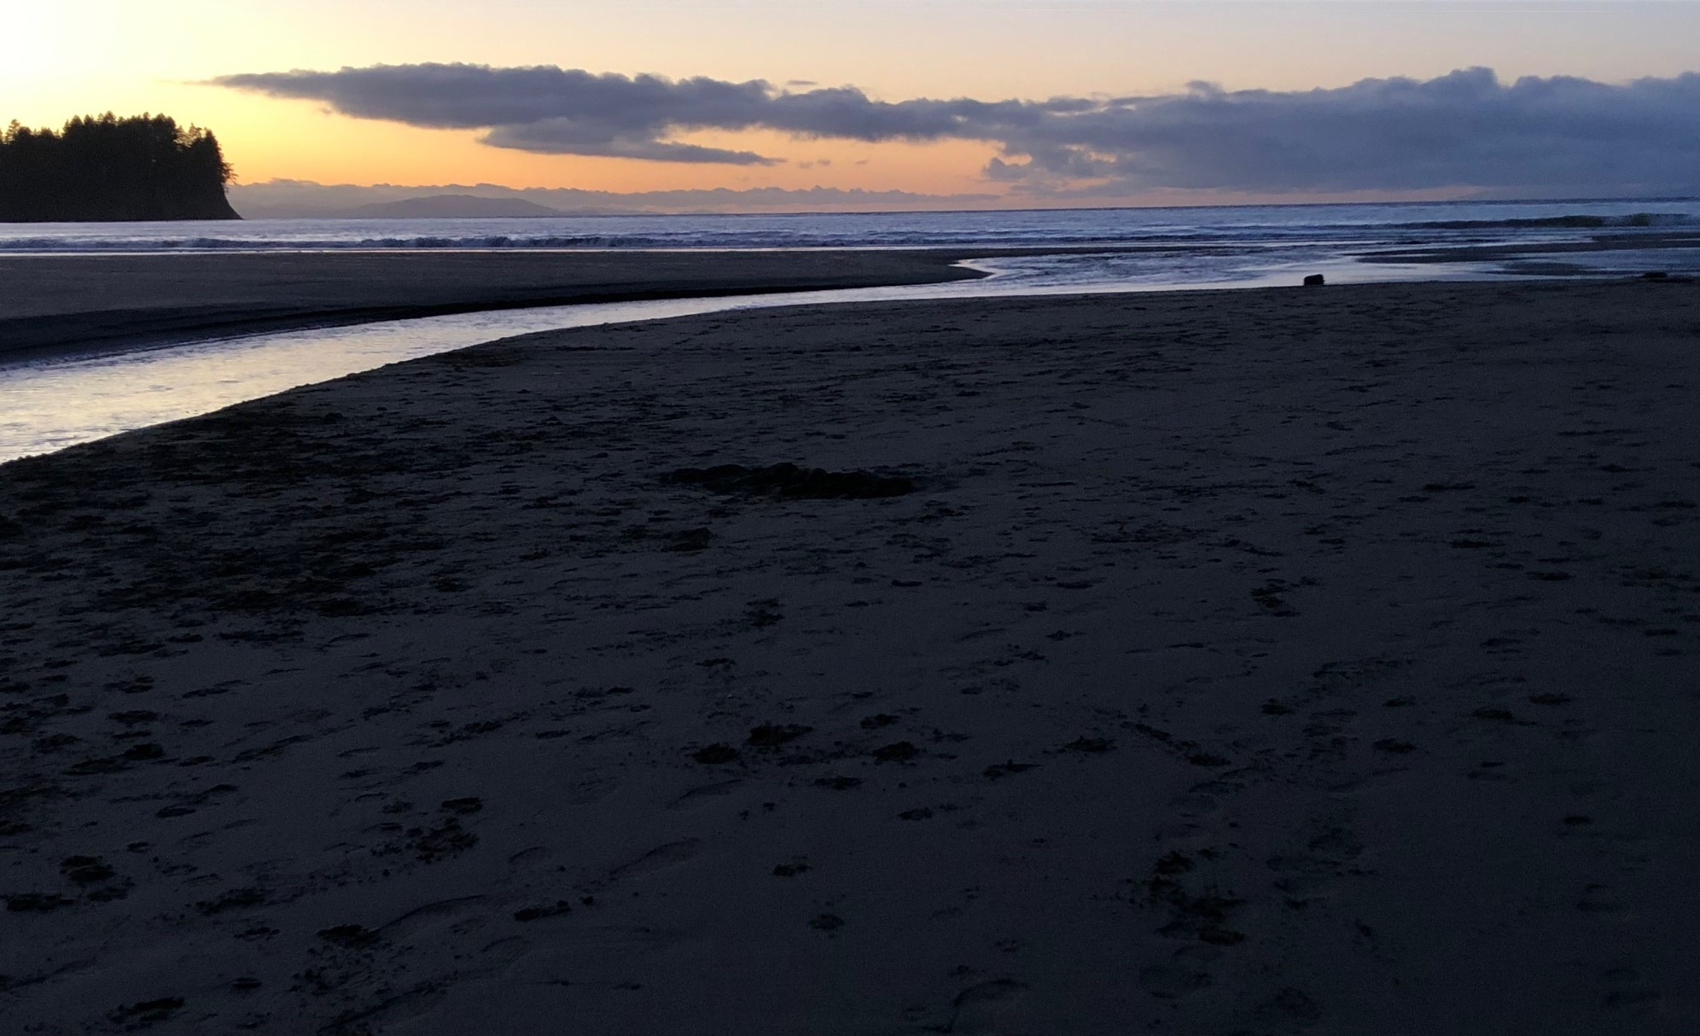
Reflections? Questions? Concerns?

Slide 33
Next Meeting Options:
June 5th or July 3rd (virtual)
Timing of next in-person (Oregon)

